Slide 1
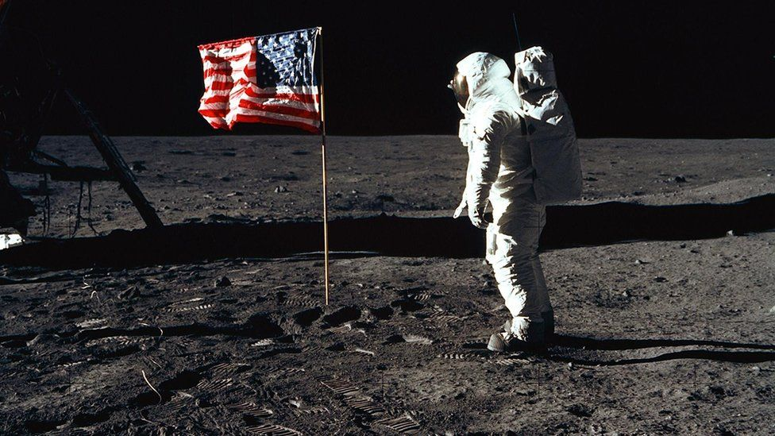
The Man on the Moon
50th Anniversary
Apollo 11 July 20th, 1969
Meagan Paese

Slide 2
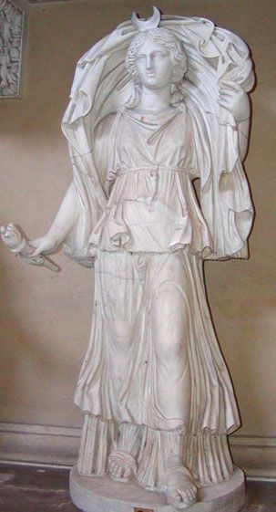
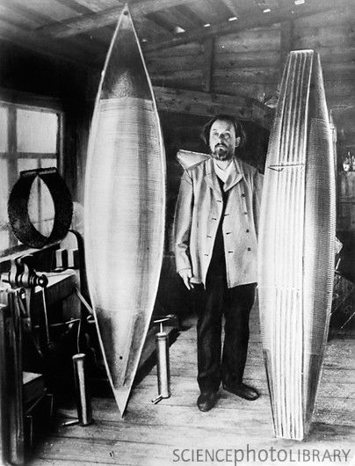
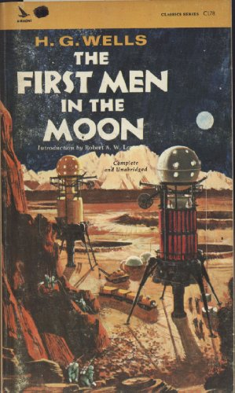
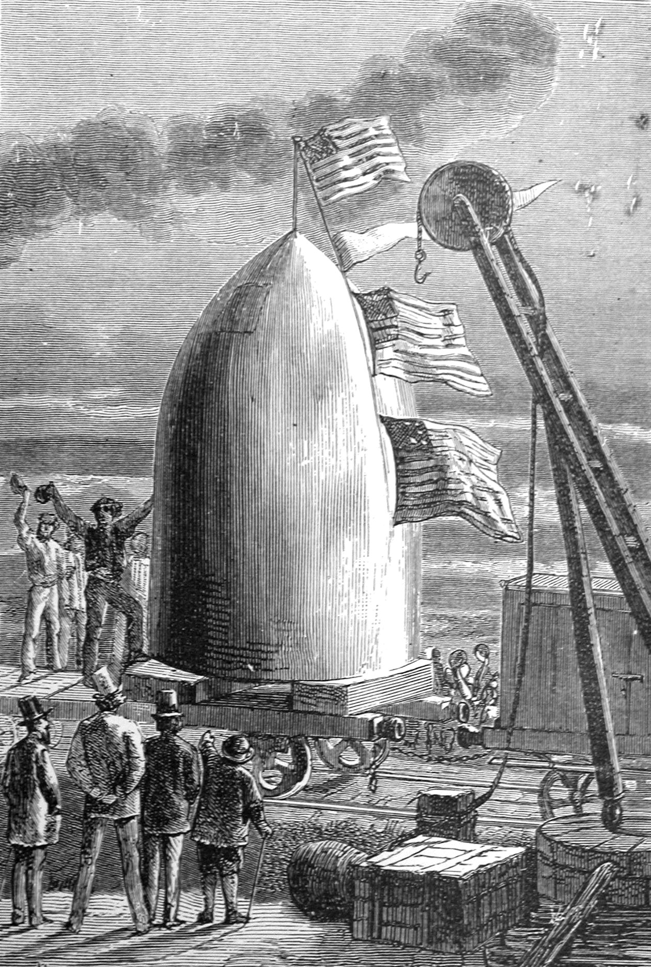
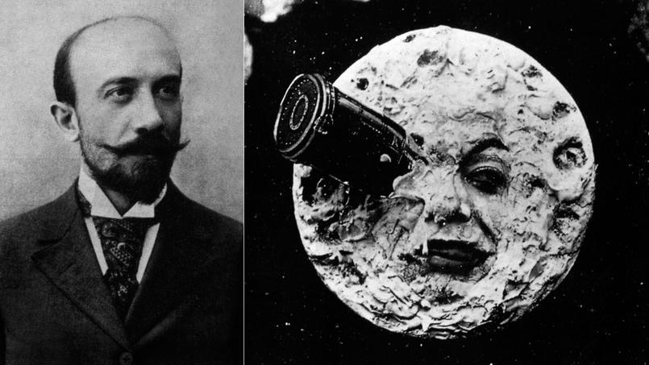
The Moon
Known as Nanna or Nammar
For Egyptians, the moon was referred as the Thoth, for the Greeks, called the Moon Selene, the goddess of night
1865, Jules Verne From the Earth to the Moon, HG Wells The First Men in the Men
Konstanin Tsiolkovsky
George Melies A Trip to the Moon

Slide 3
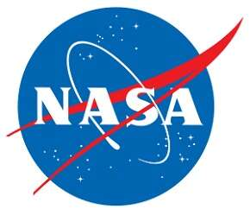
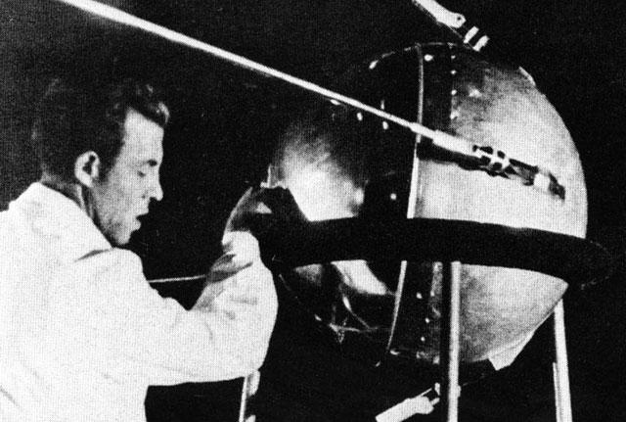
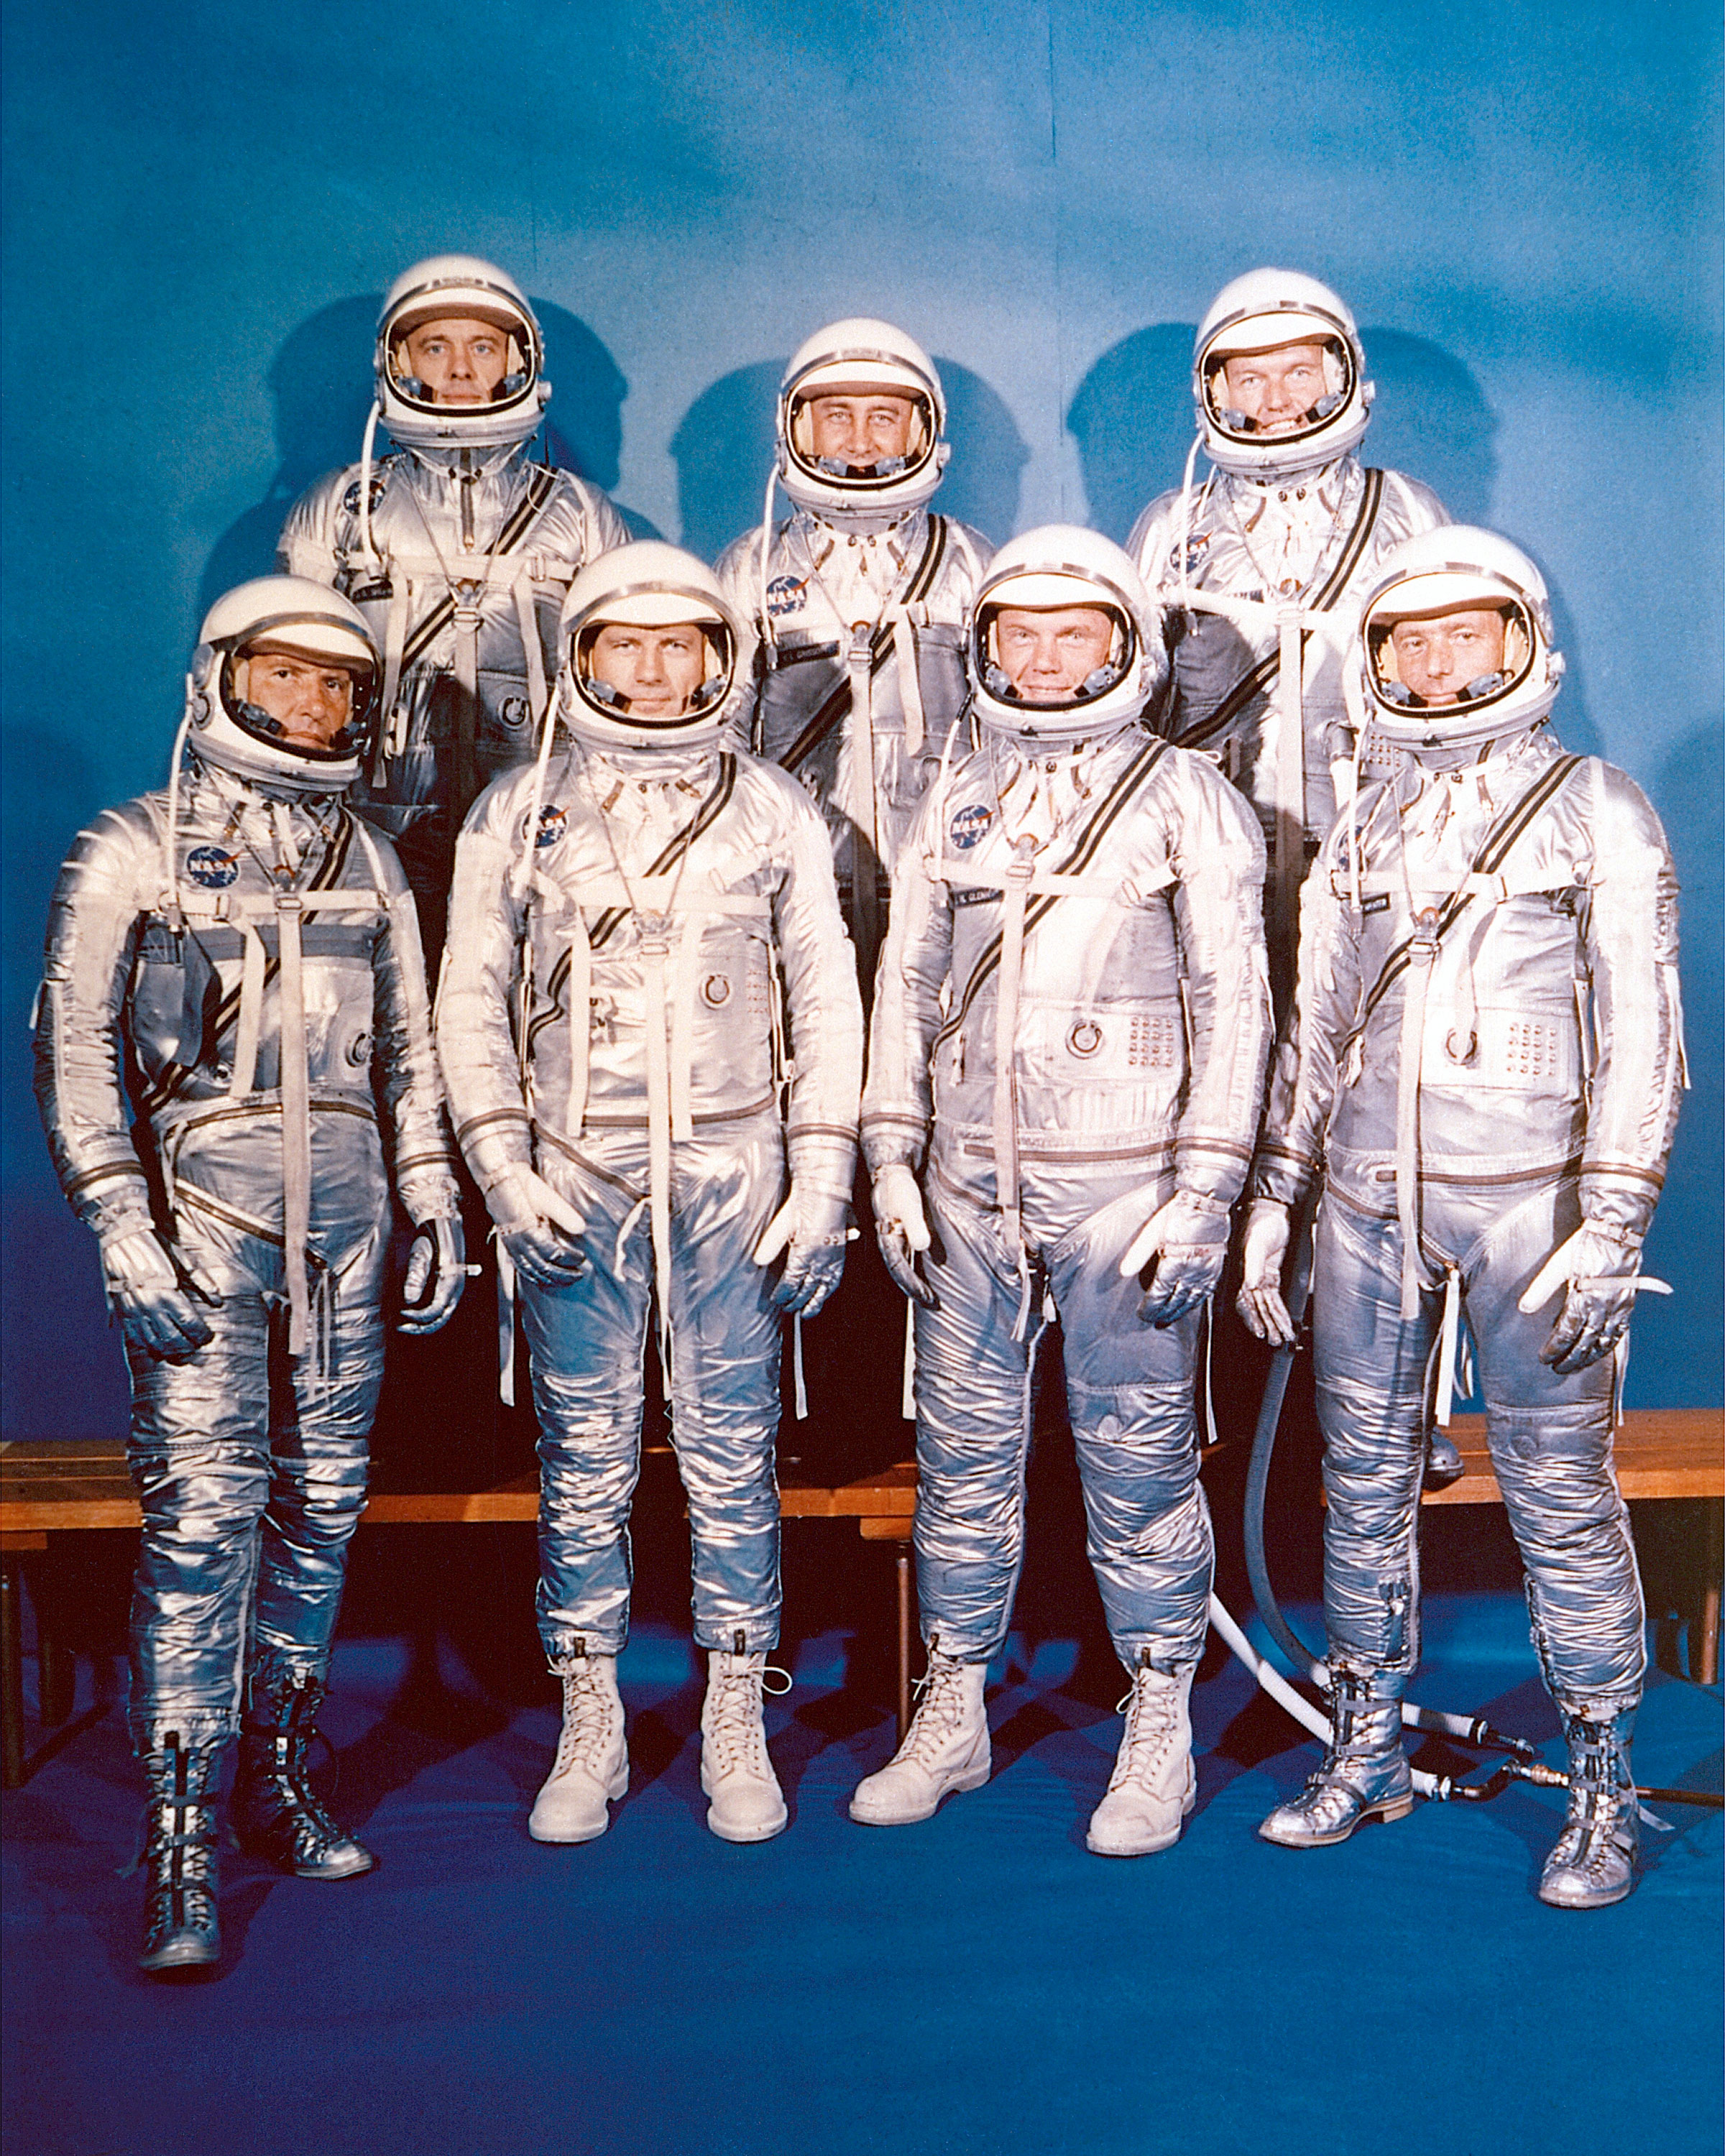
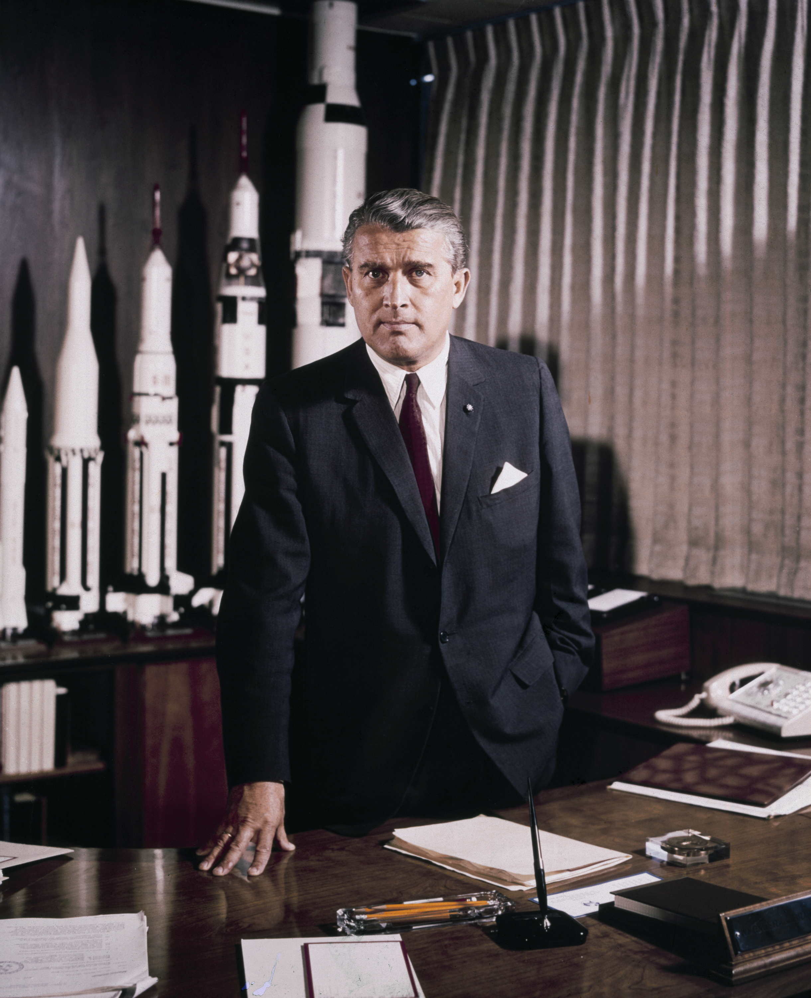
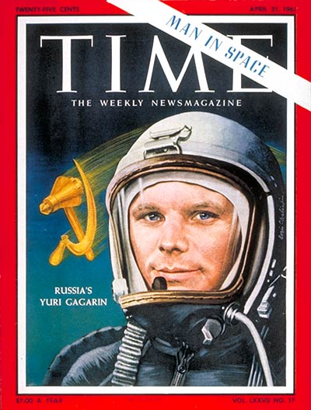
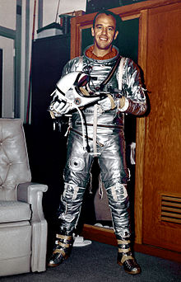
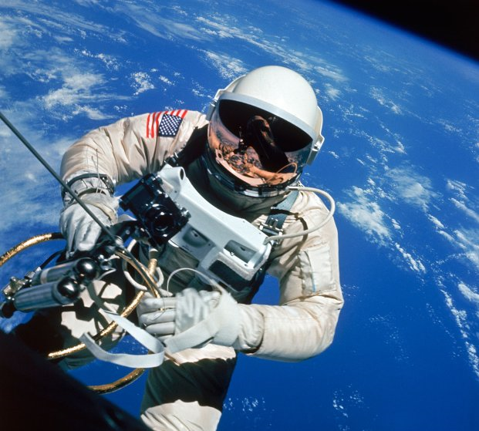
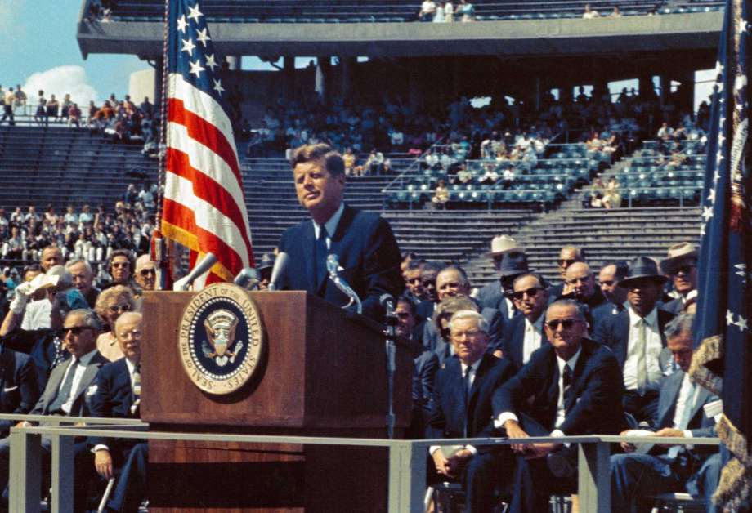
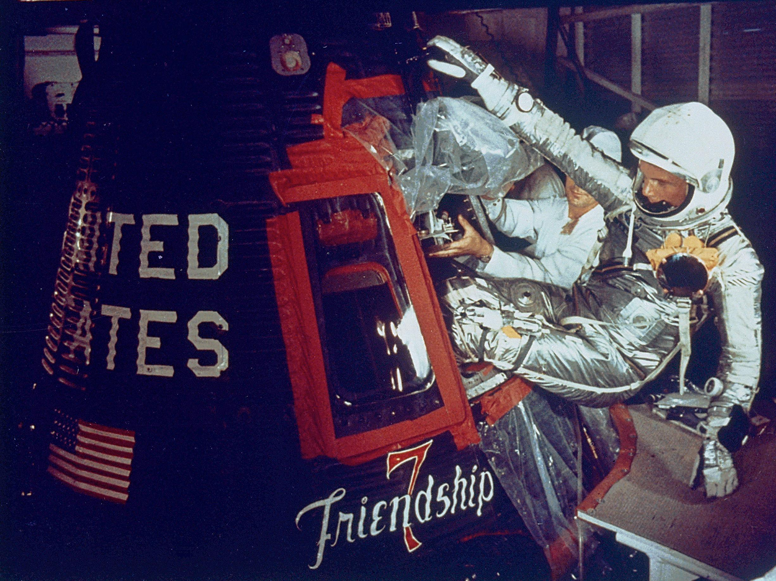
Space Race
The Soviets launched the Sputnik
NASA
Mercury Seven
Yuri Gagarin, Alan Shepard, John Glenn
Gemini
John F. Kennedy: “We Choose to Go to the Moon”

Slide 4
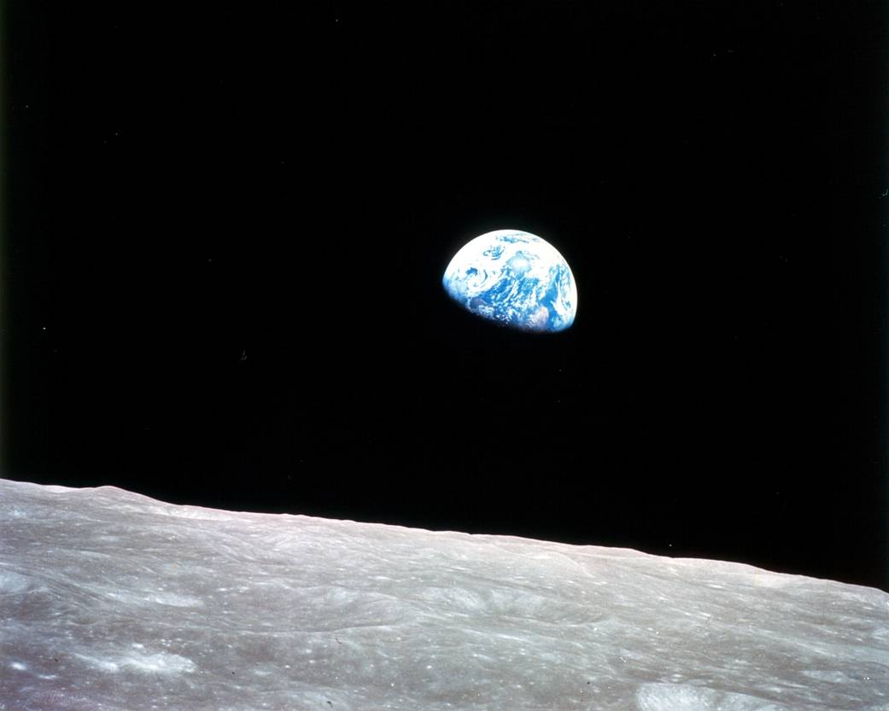
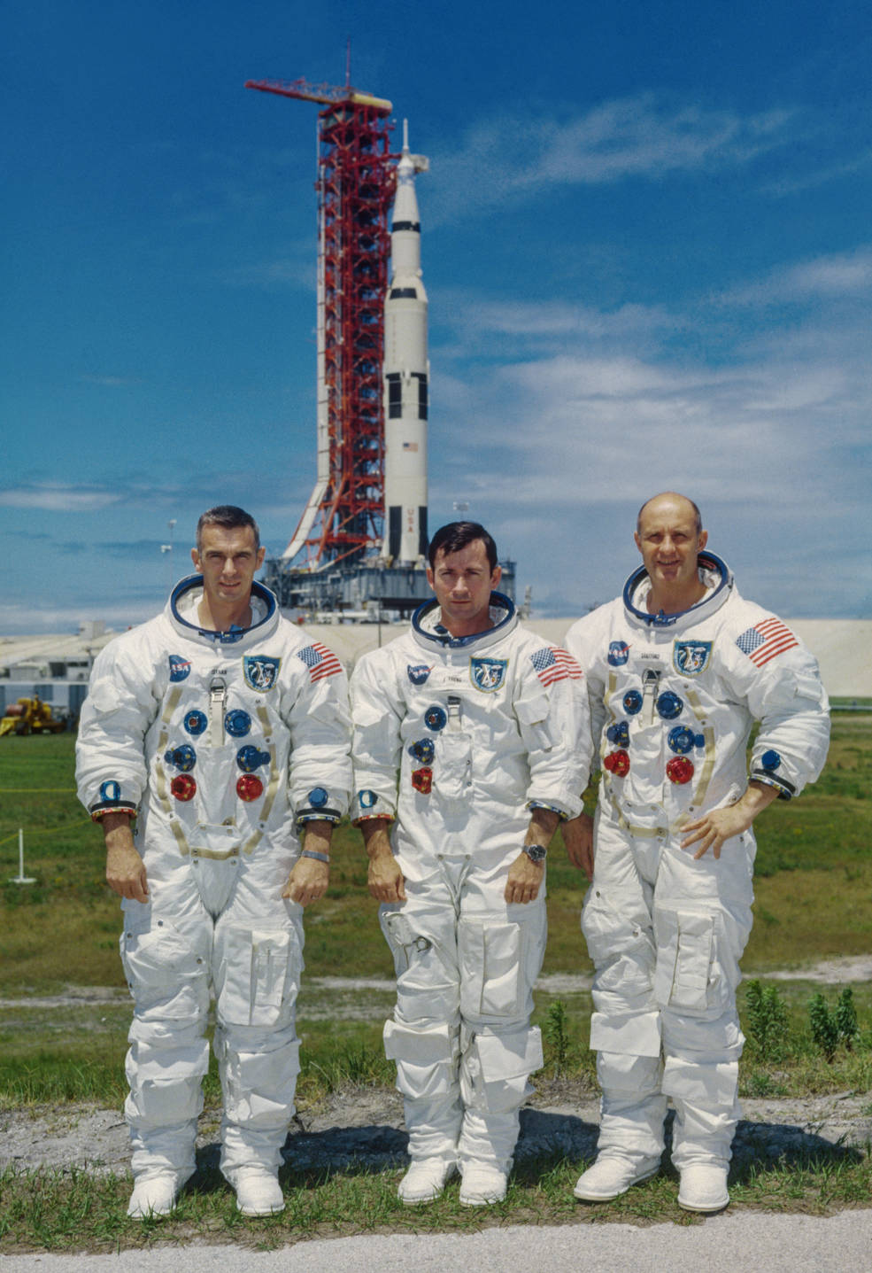
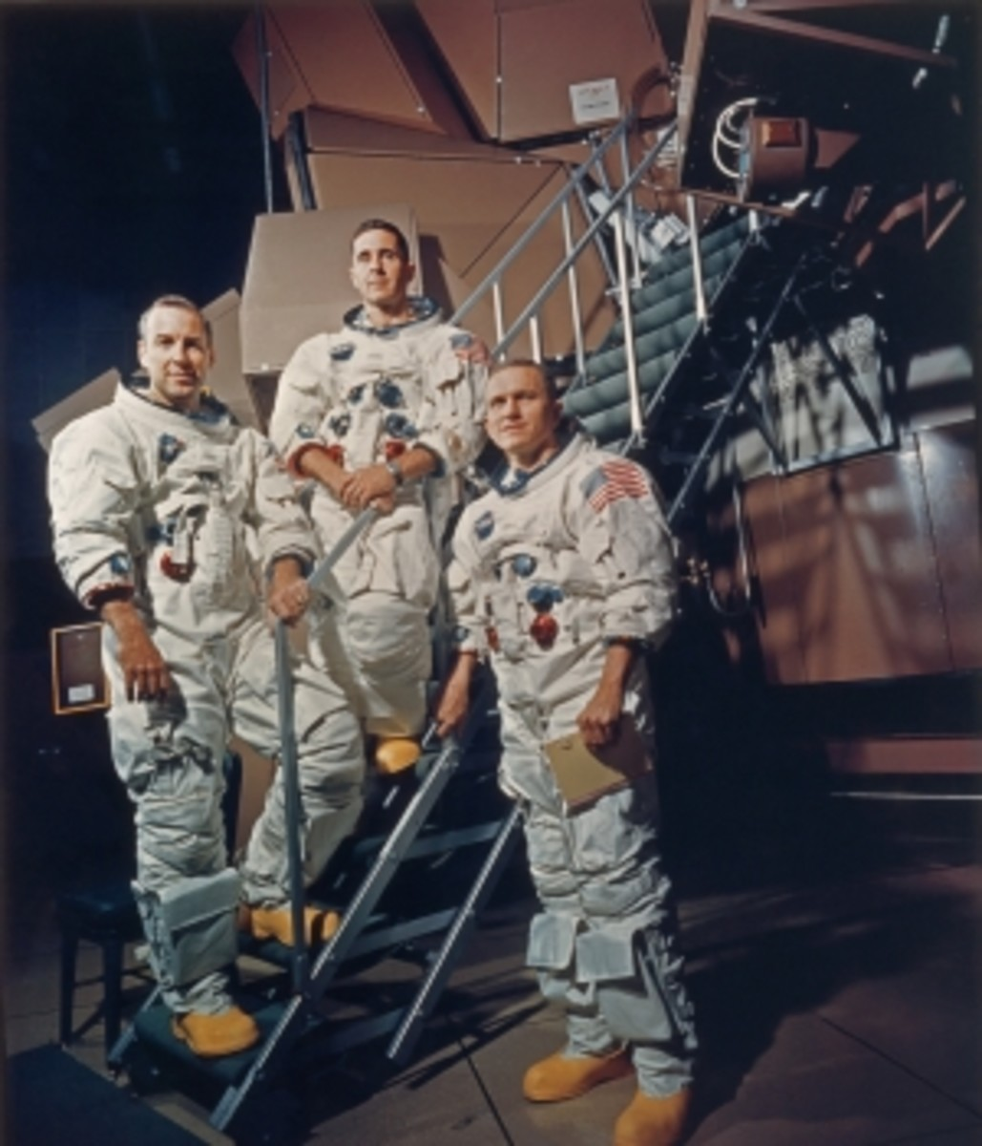
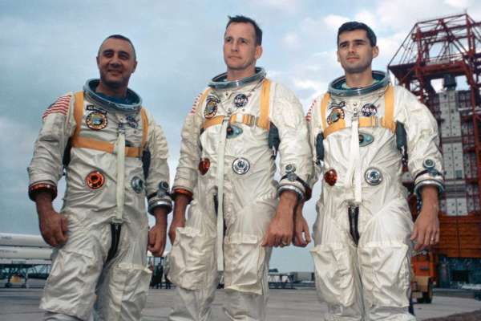
Apollo Program
Apollo 1
Apollo 8
Apollo 10

Slide 5
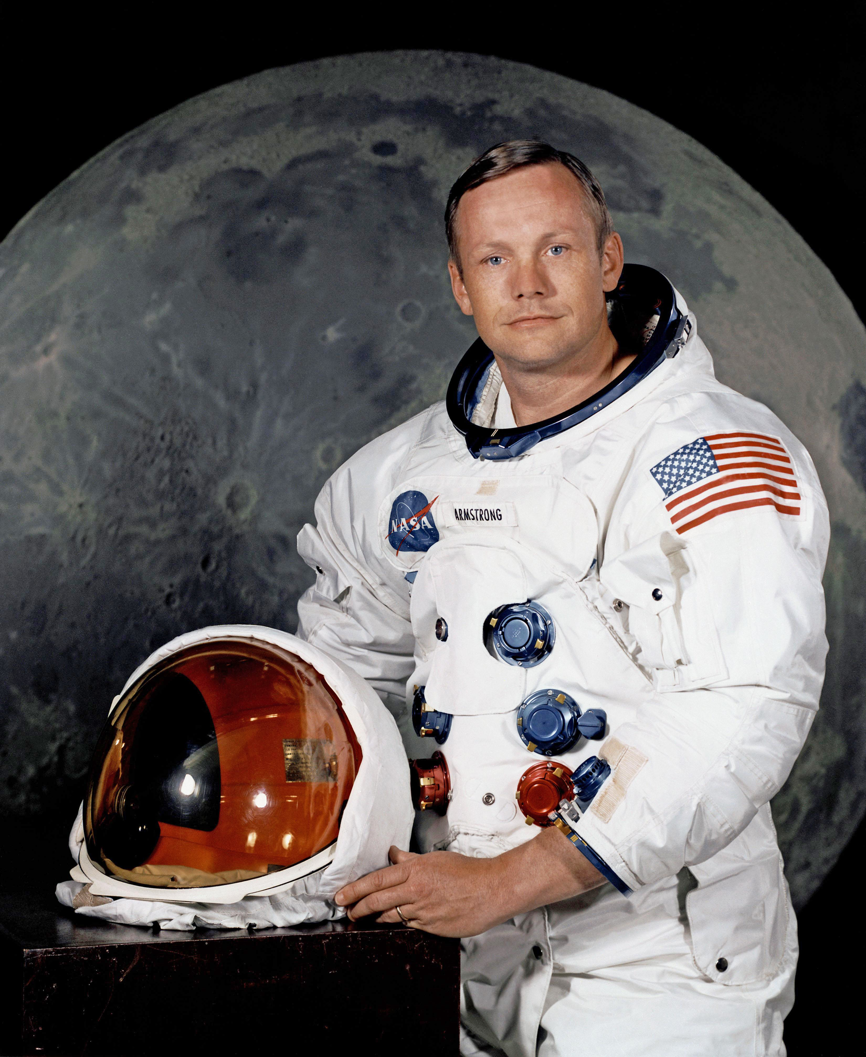
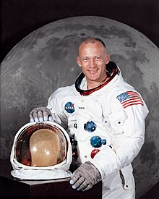
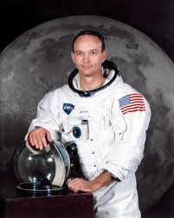
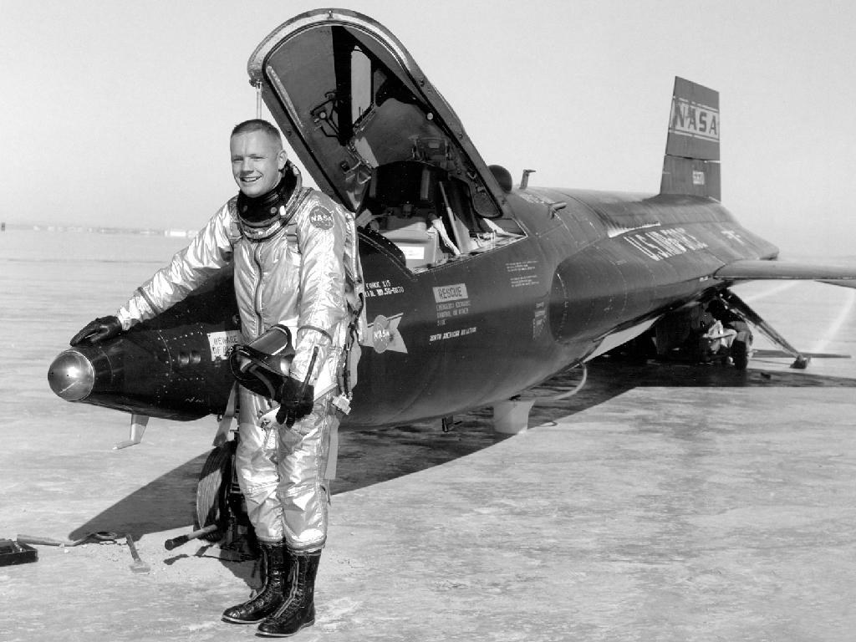
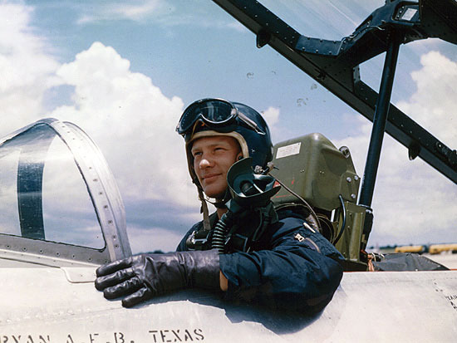
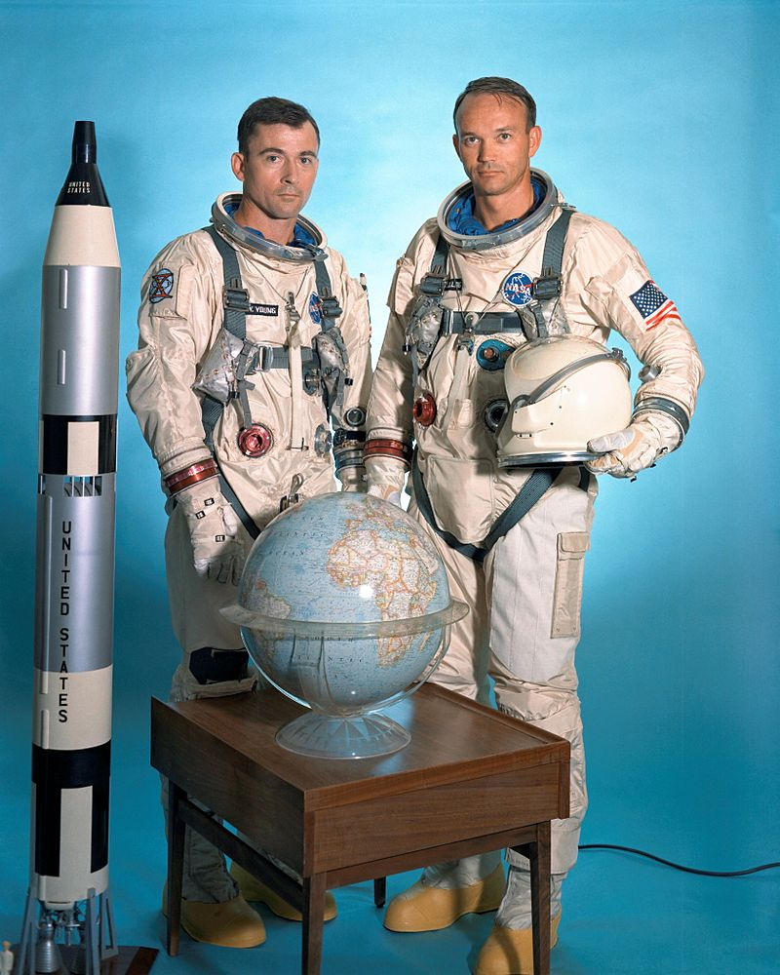
Apollo 11: Astronauts
Neil Armstrong
Buzz Aldrin
Michael Collins

Slide 6
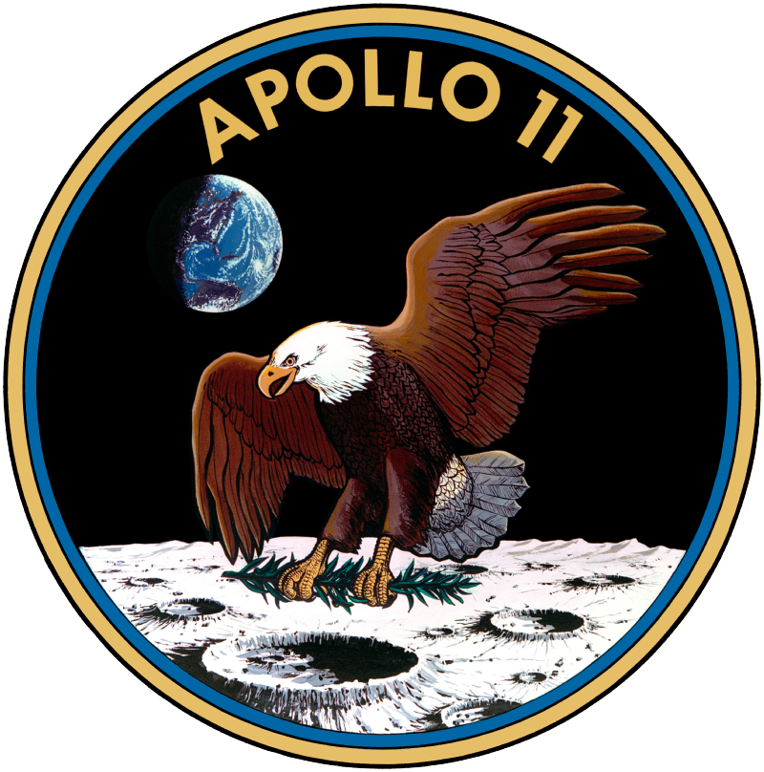
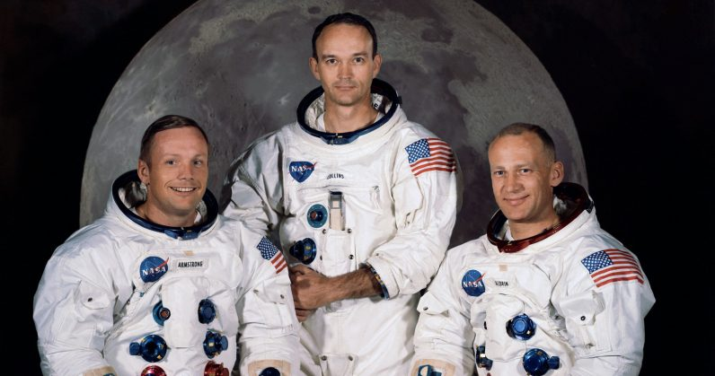
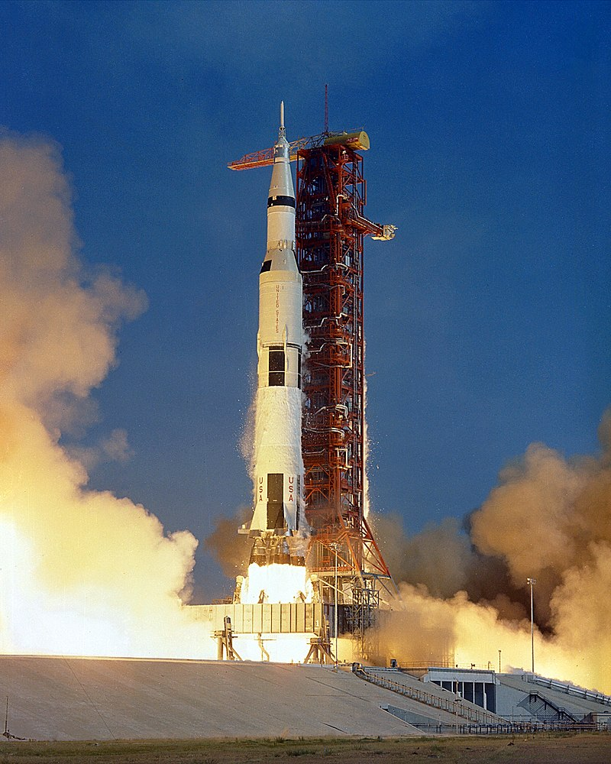
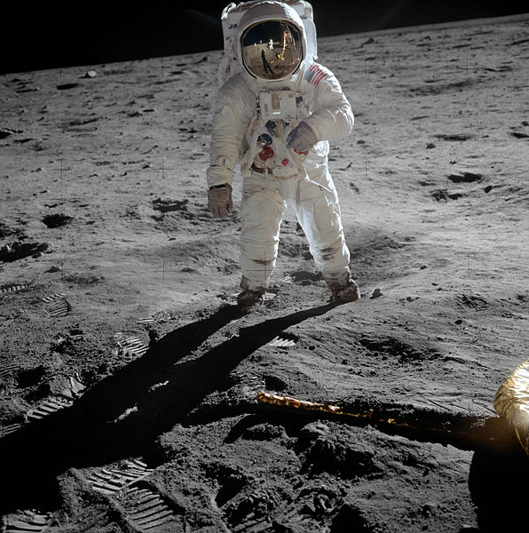
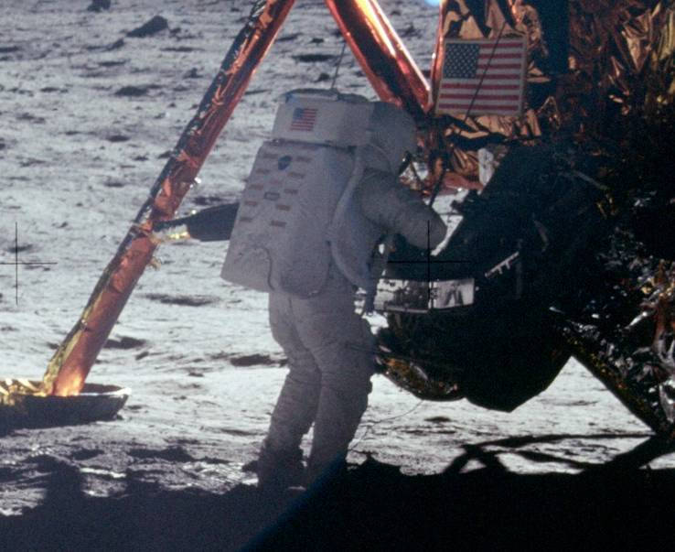
Apollo 11: On the Moon
Saturn V AS-506 launched Apollo 11 on July 16, 1969.
On July 19, 1969, Apollo 11 passed behind the Moon and fired its service propulsion engine to enter lunar orbit.
Landed on the Moon on July 20, 1969.
Neil Armstrong: “That’s one small step for [a] man, one giant leap for mankind. "Armstrong's first step onto the lunar surface was broadcast on live TV to a worldwide audience.
Walter Cronkite: “The Eagle has Landed”

Slide 7
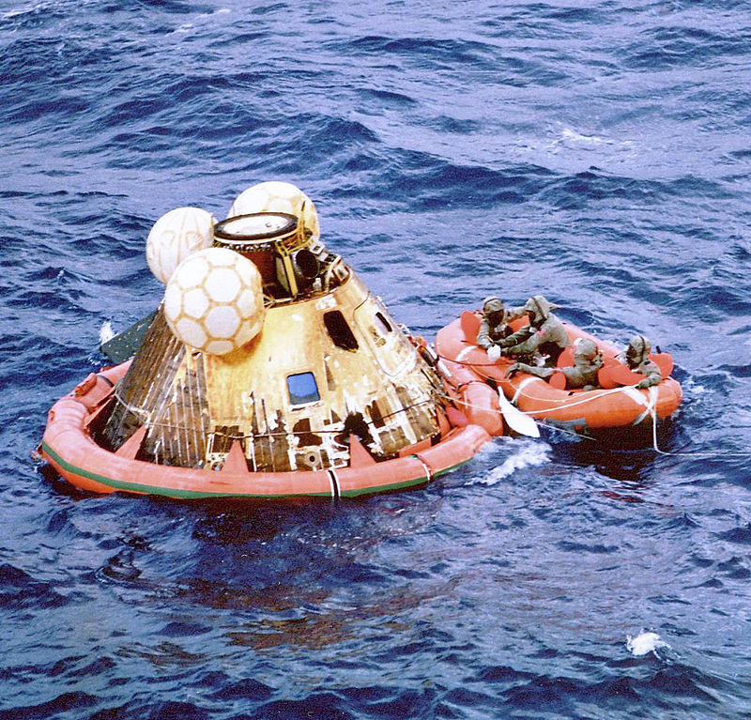
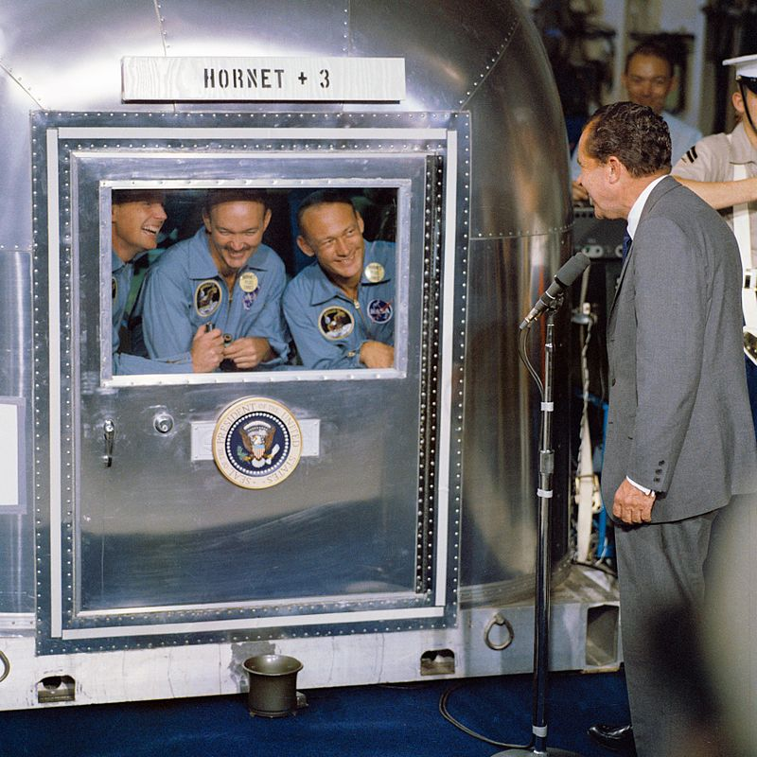
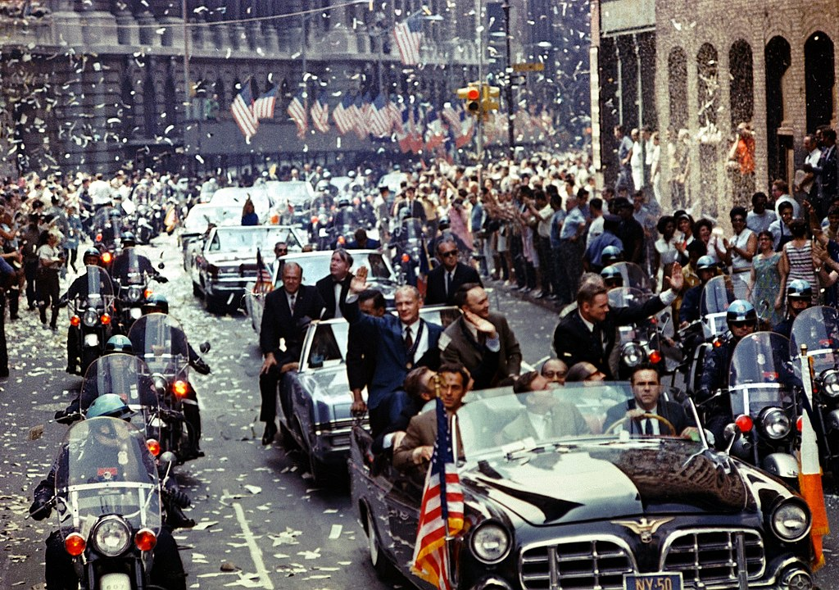
Safely Return to Earth
Splashdown on July 24, 1969
Celebrations
Ticket-Tape Parade

Slide 8
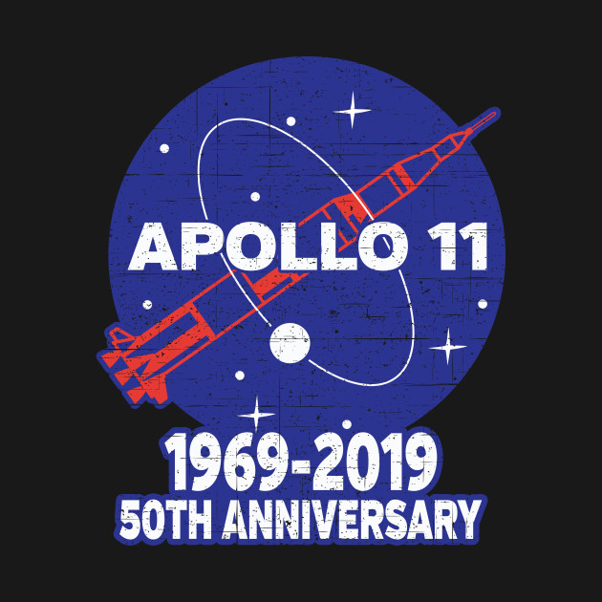
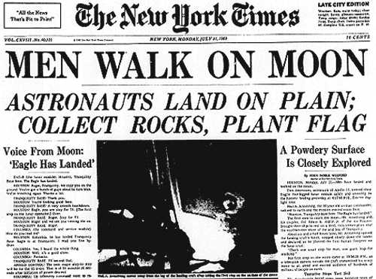
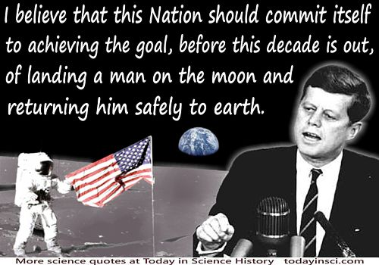
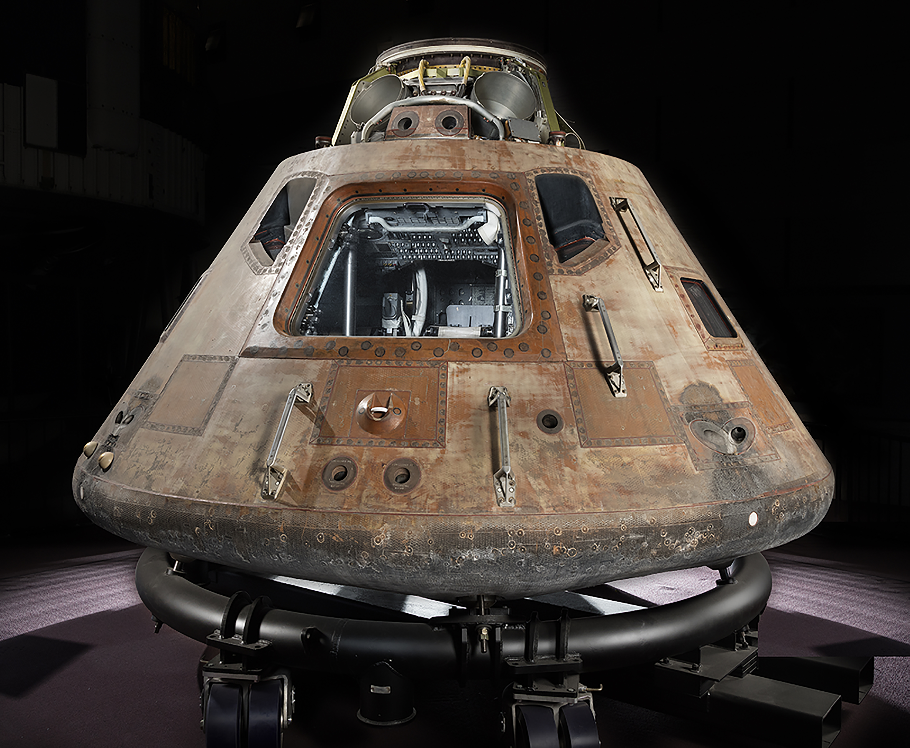
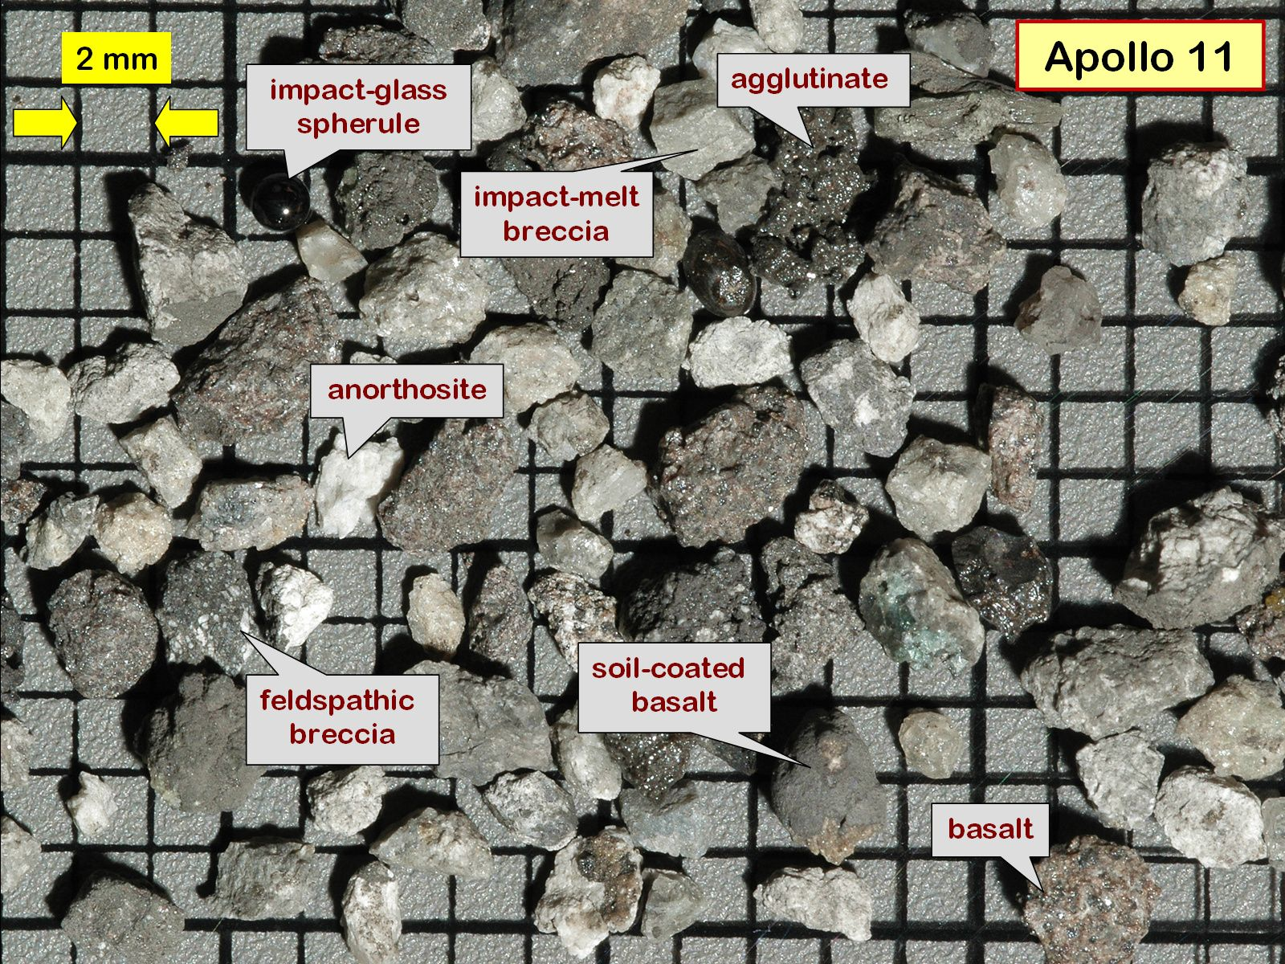
Legacy
Humans walking on the Moon and returning safely to Earth accomplished Kennedy's goal.
Columbia displayed at the Smithsonian Institution
Moon Rocks
50th Anniversary

