Slide 1
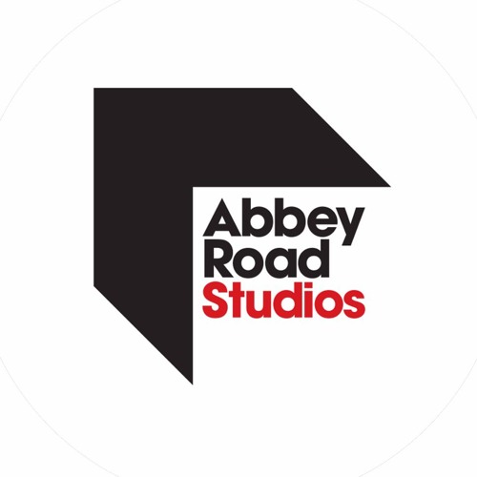
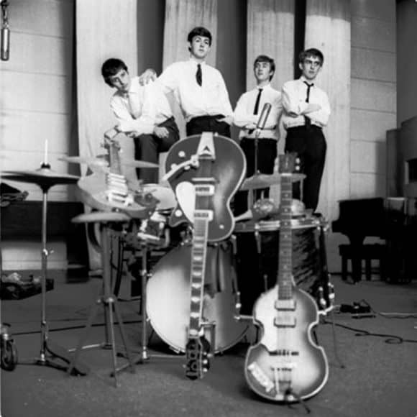
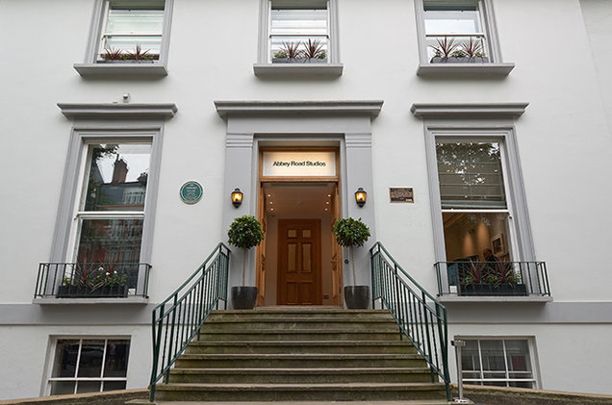
Abbey Road Studios
Behind the Scene, Backgrounds, and Music, and the Beatles
Meagan Paese

Slide 2
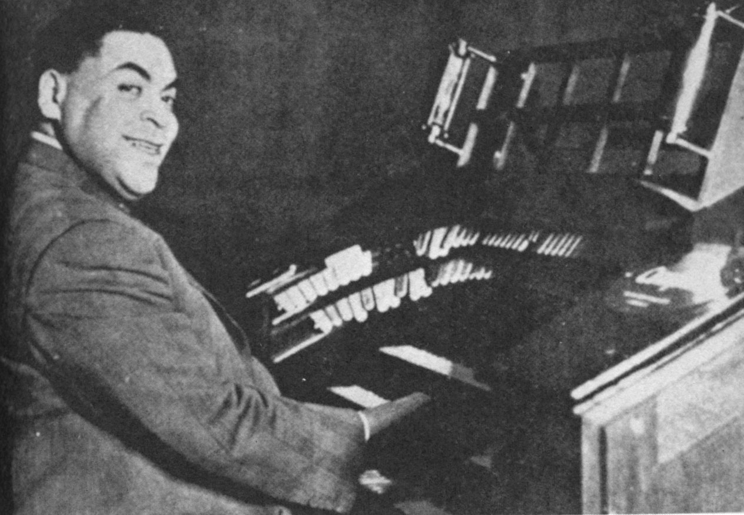
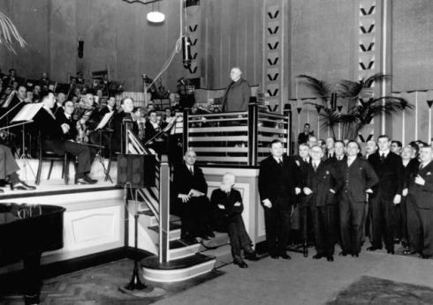
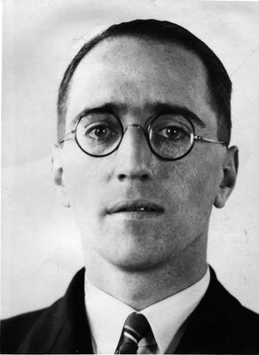
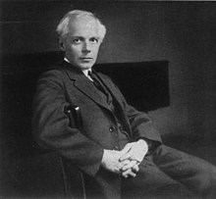
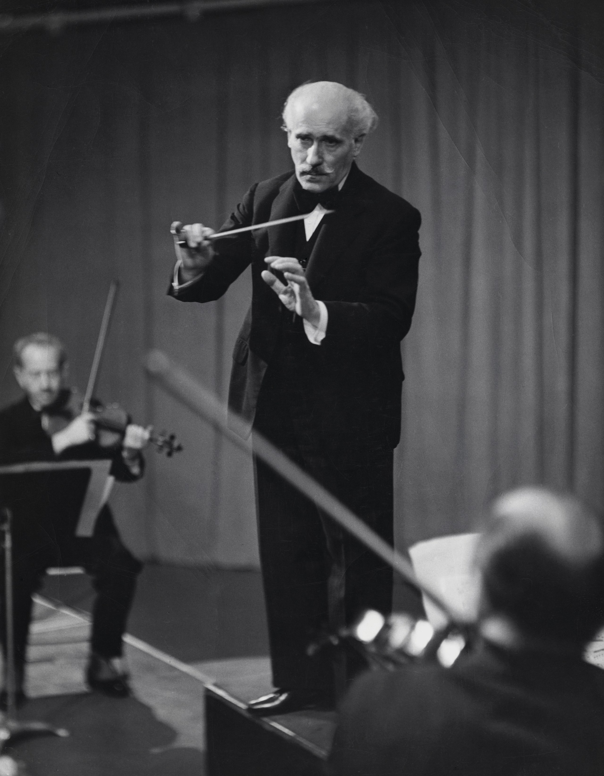
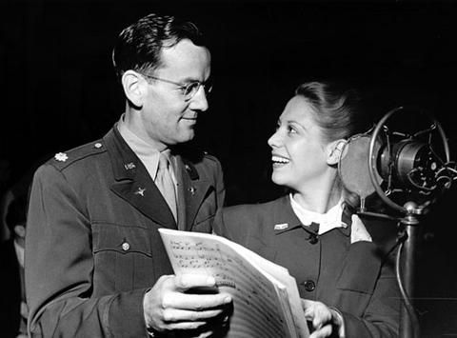
Beginning of Abbey Road
Was originally a nine-bedroom Georgian townhouse built in 1831
Gramophone Company
Studio opened in November 1931
Edward Elgar
Alan Blumlein, recorded Mozart’s Jupiter Symphony which was conducted by Thomas Beecham
Classical, concertos, operettas, jazz and music hall
World War II

Slide 3

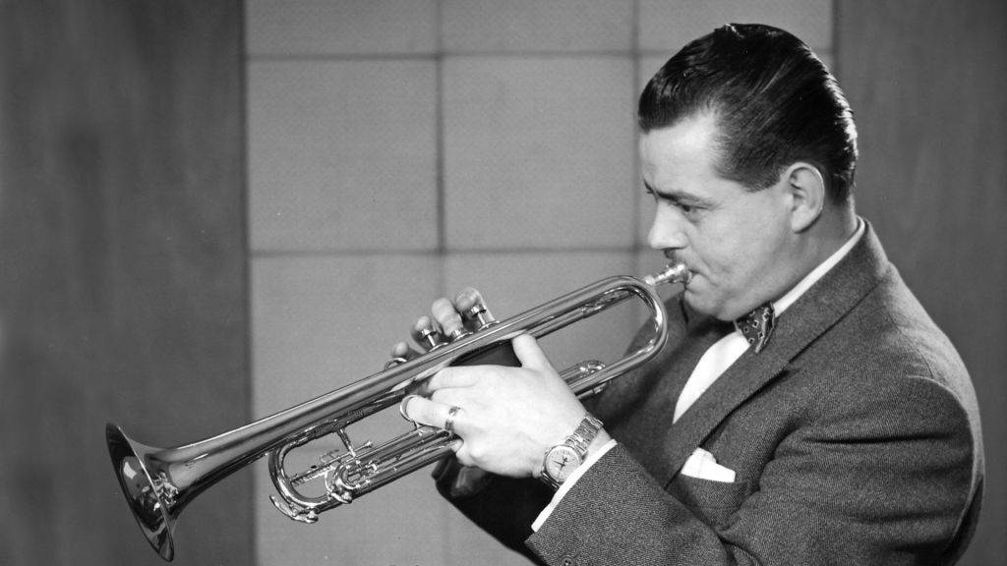
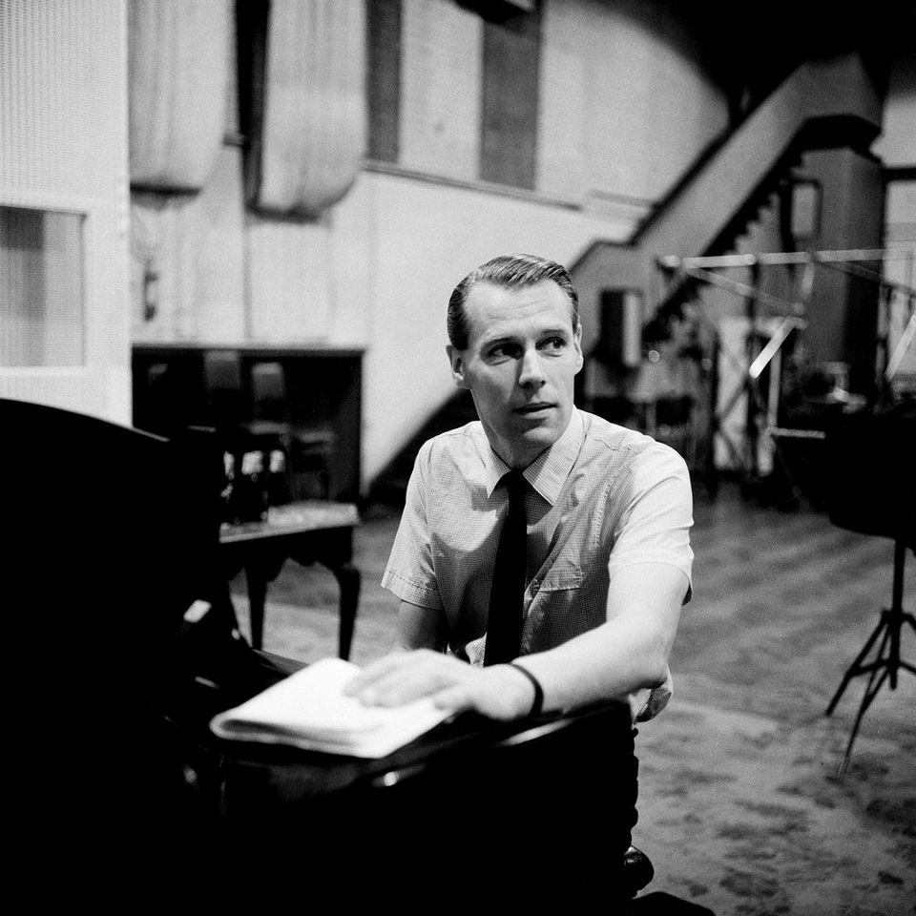
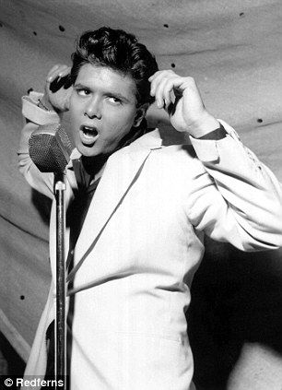
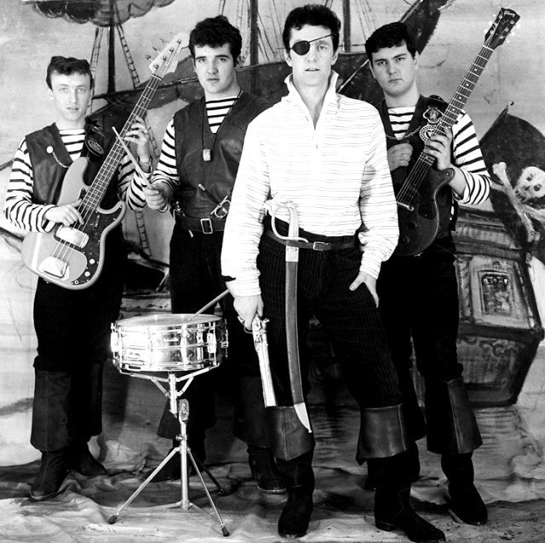
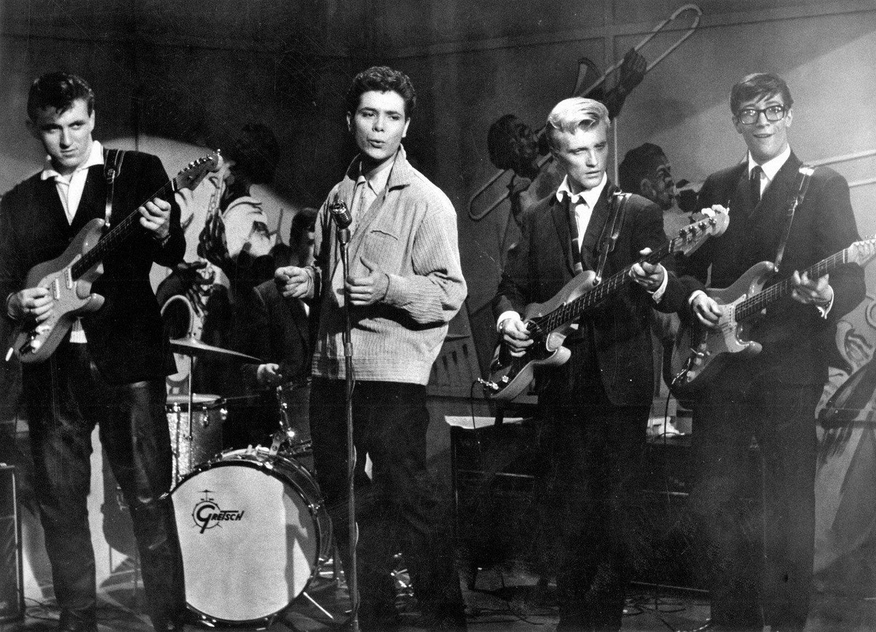
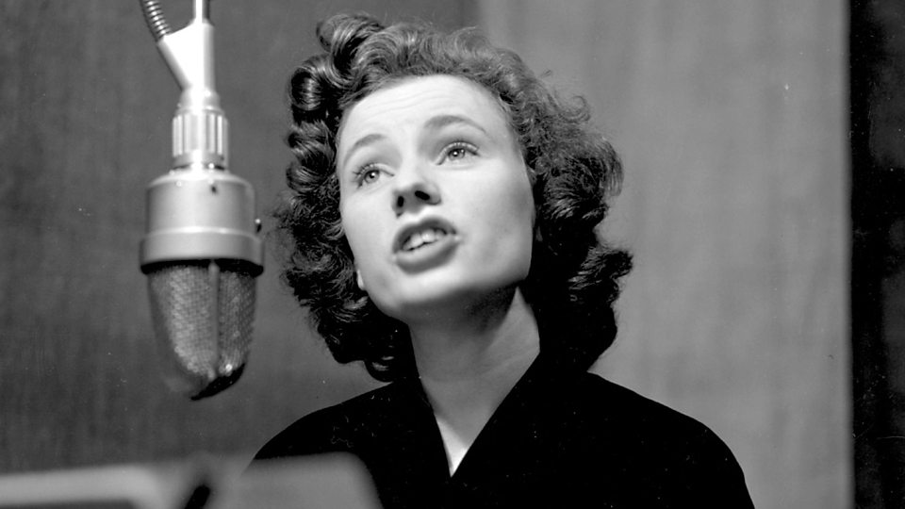
1950s/Rock ‘n’ Roll/Producers
Electric and Musical Industries (EMI)
Four men with music backgrounds
George Martin
Rock and Roll was introduced

Slide 4
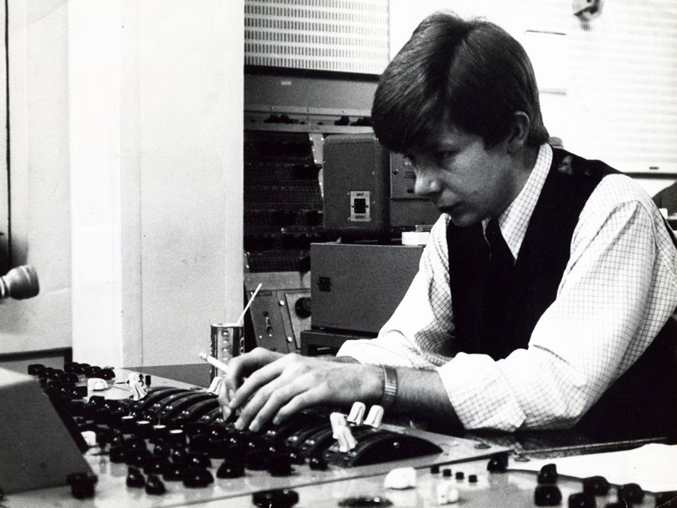
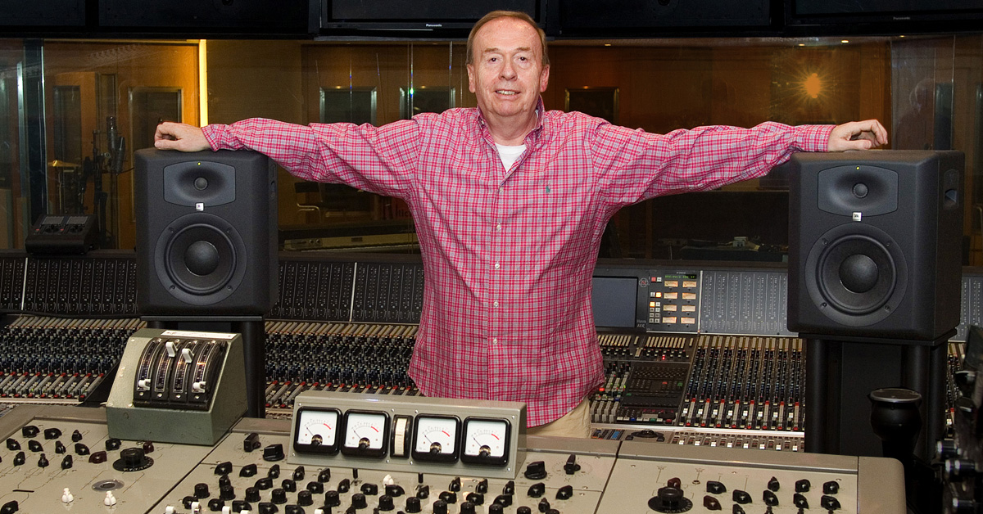
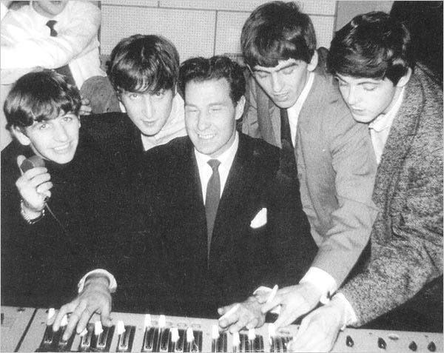
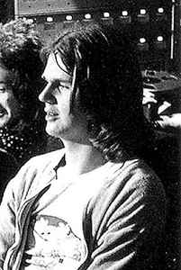
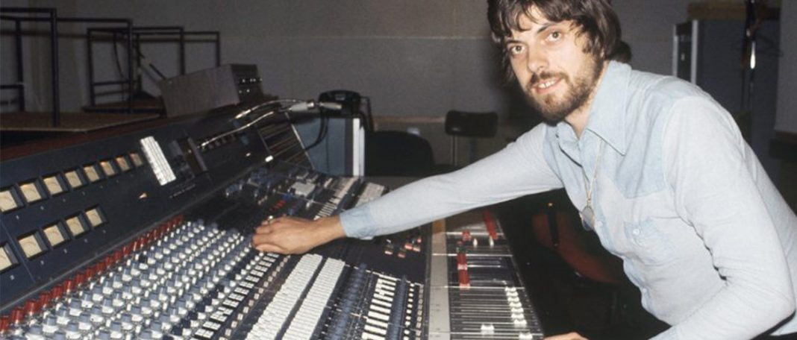
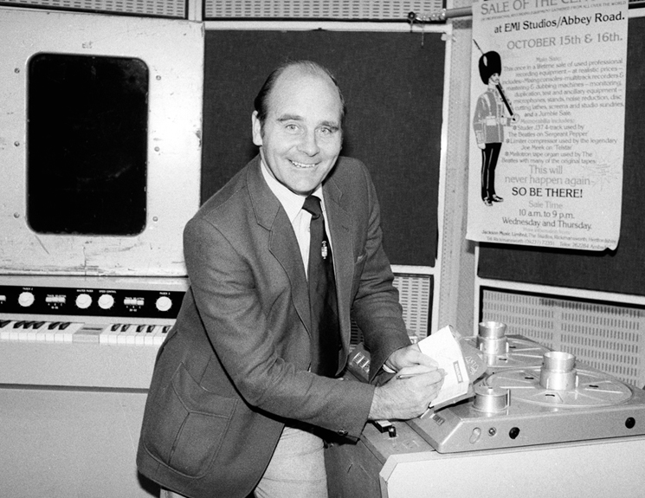
Engineers
Ken Scott
Geoff Emerick
Norman Smith
Mike Stone
Alan Parsons
Ken Townshend

Slide 5
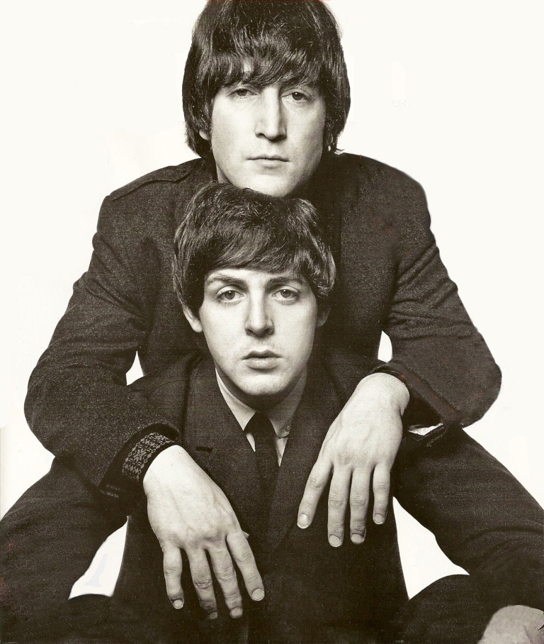
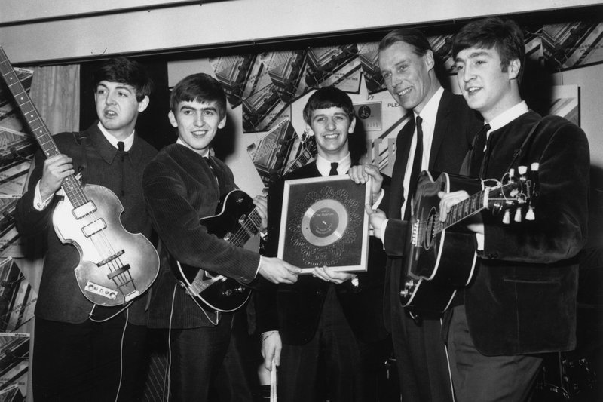
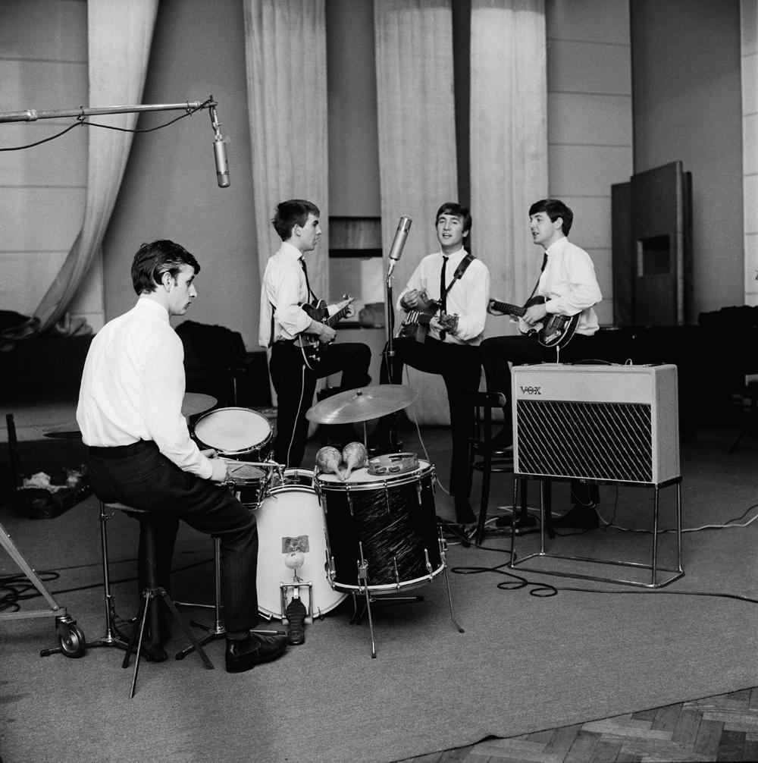
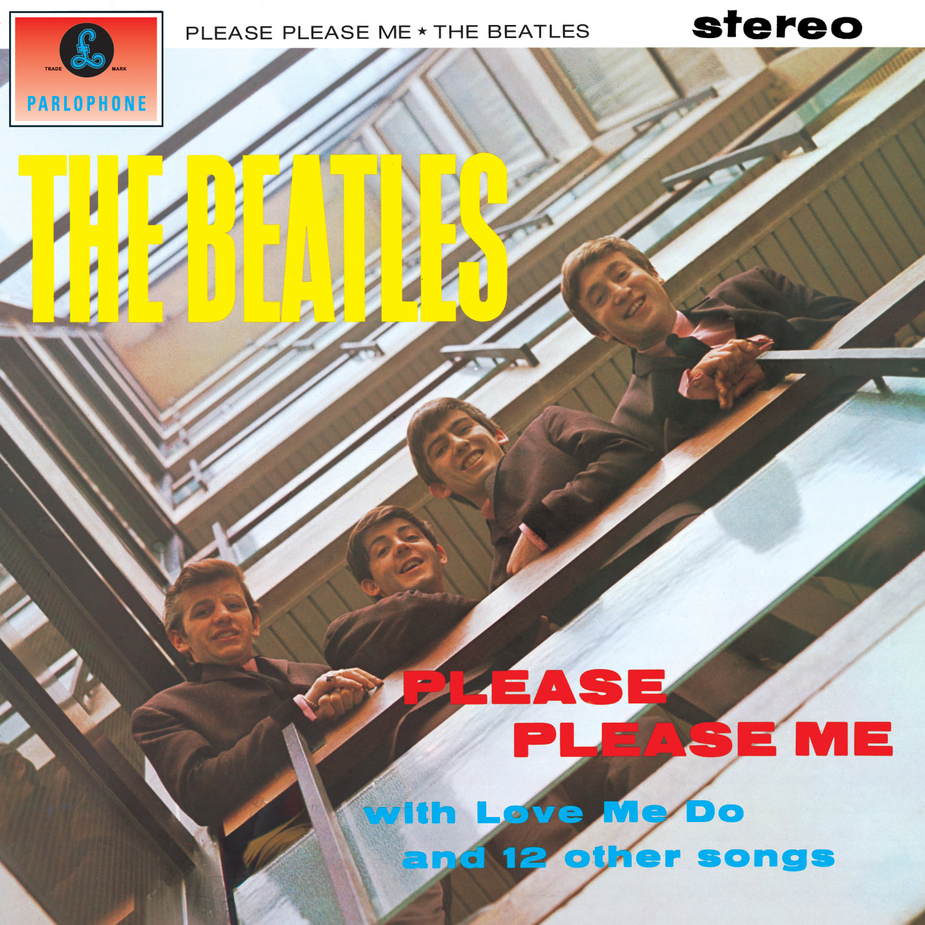
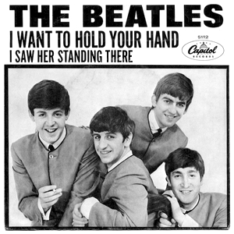
The Beatles
George Martin signed the Beatles to EMI’s Parlophone label in 1962
First recording session took place in Abbey road Studios on June 6th 1962
Love Me Do
Lennon-McCartney
First album Please Please Me
I Want to Hold Your Hand

Slide 6
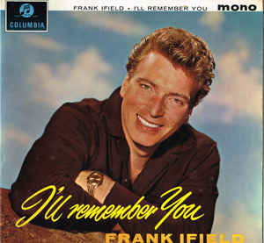
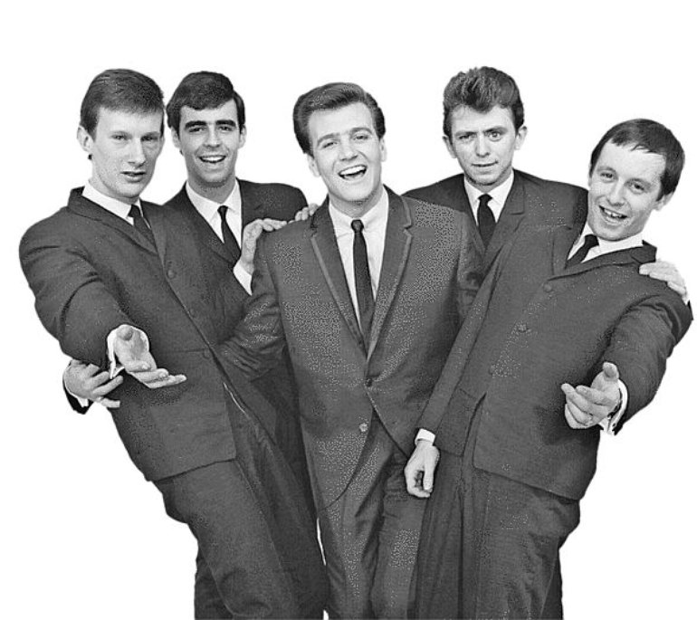
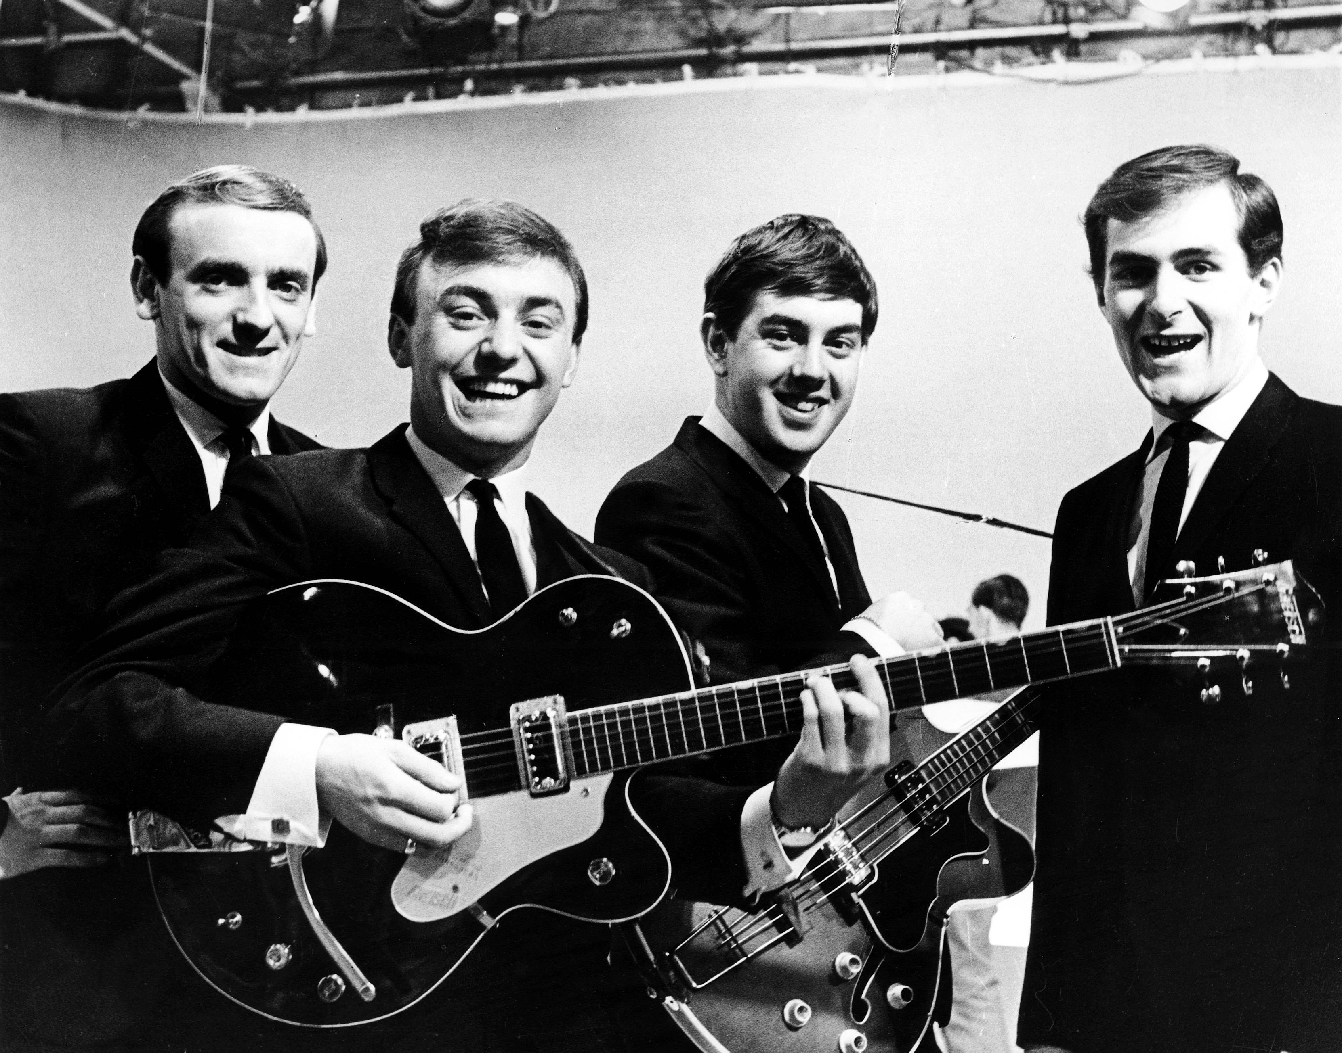
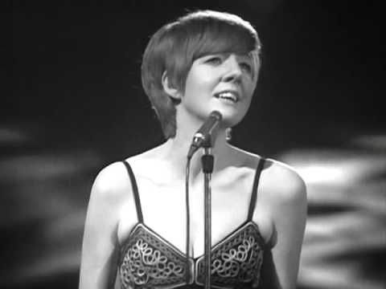
Other Artists at Abbey Road
Frank Ifield “I Remember You”
Billy J. Kramer/the Dakotas
Gerry and the Pacemakers
Cilla Black

Slide 7
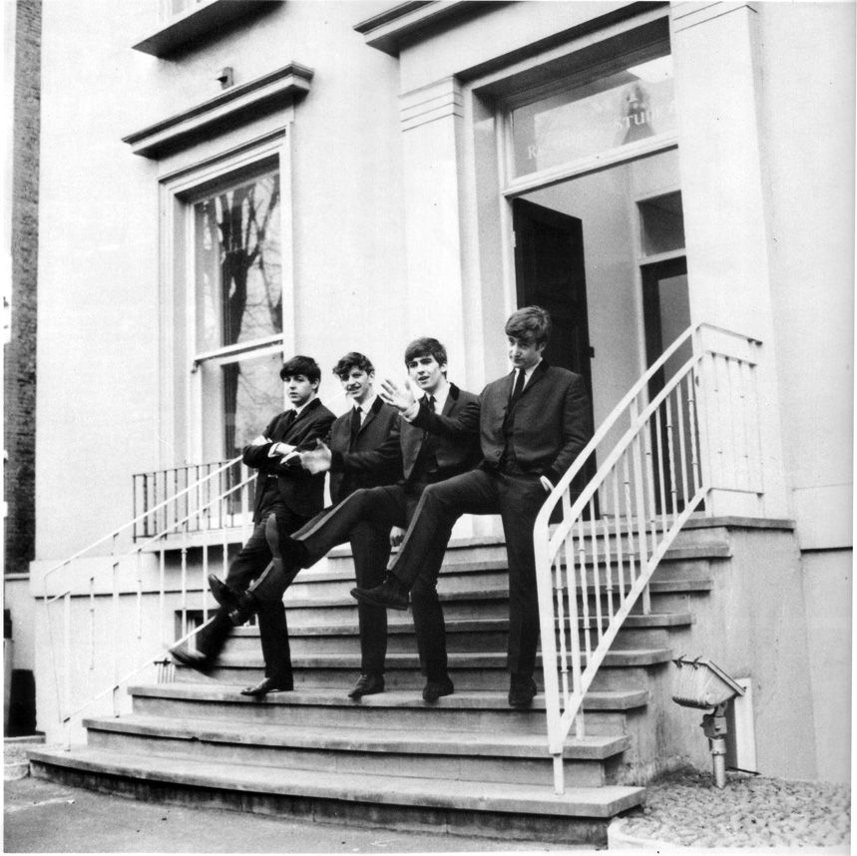
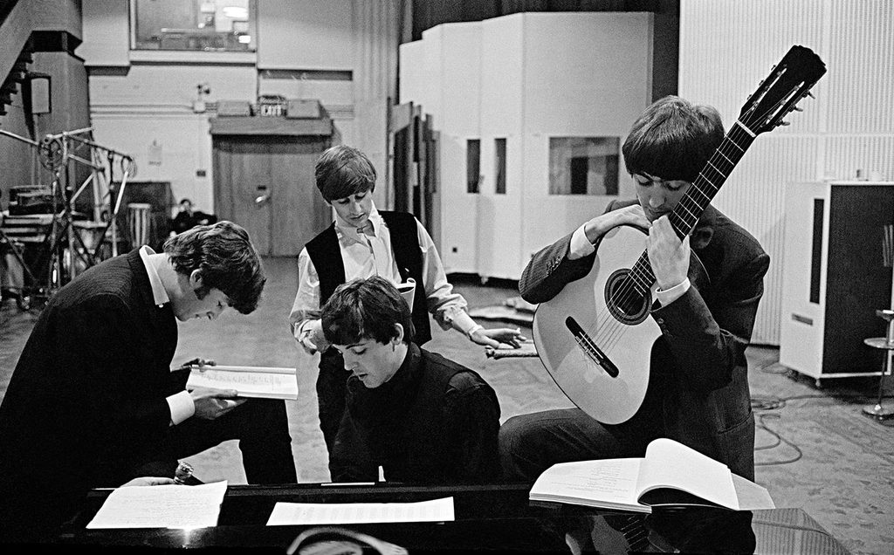
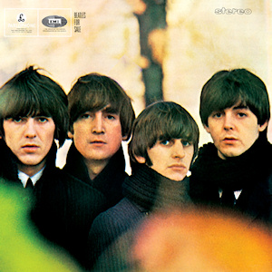
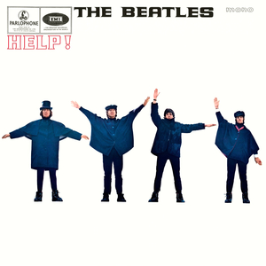
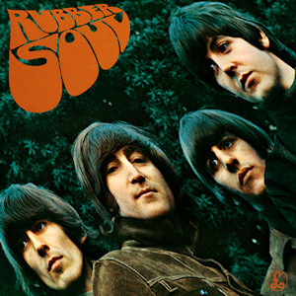
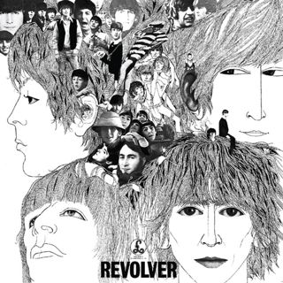
Beatles Albums
Beatles for Sale
Help!
Rubber Soul
Revolver
AIR (Associated Independent Recording) founded by George Martin and his partner John Burgess

Slide 8
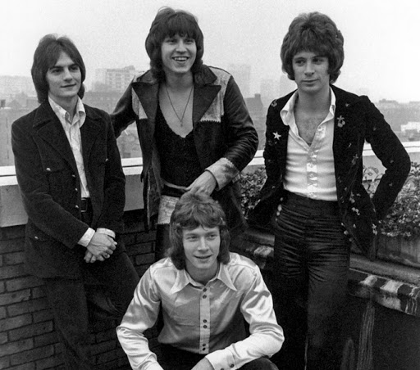
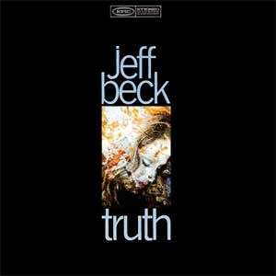
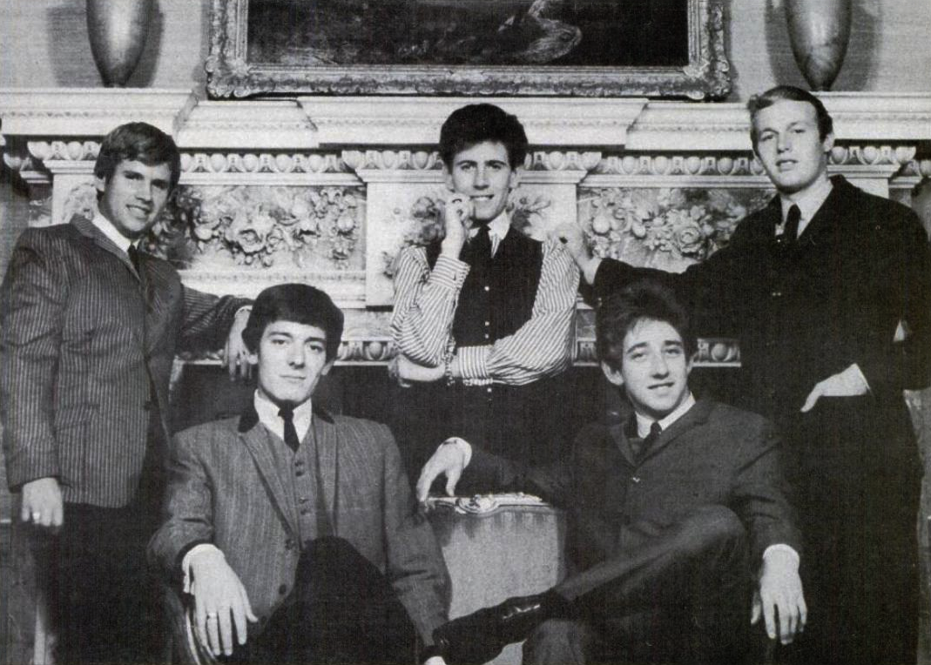
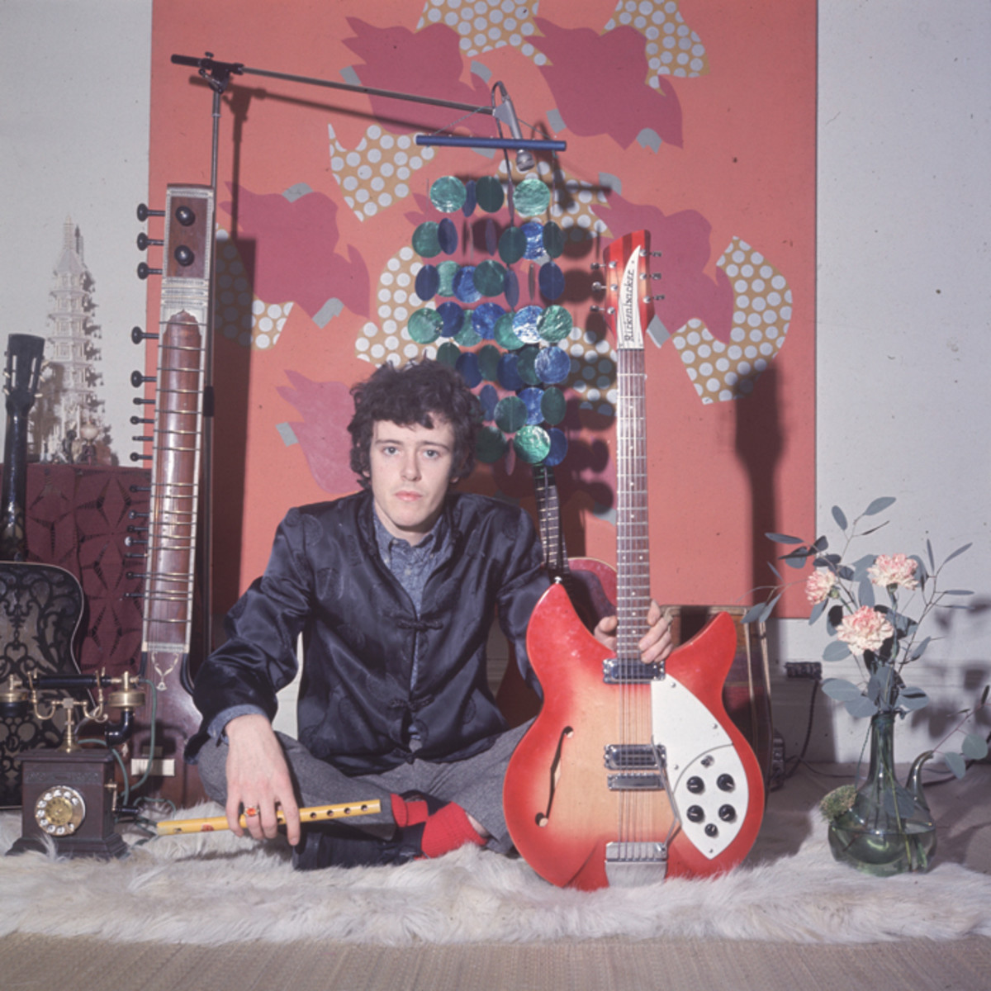
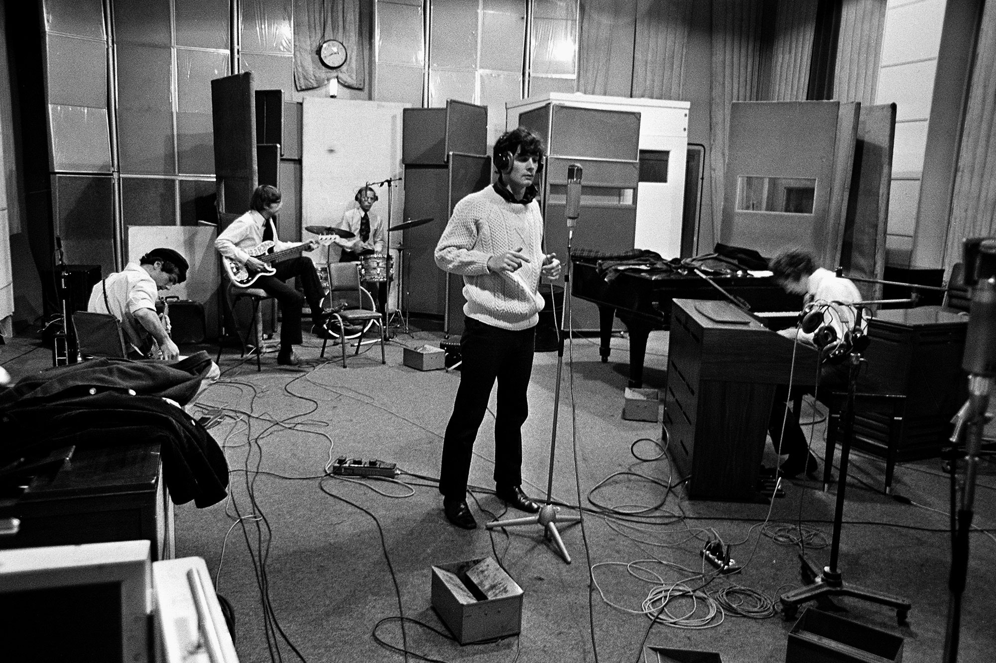
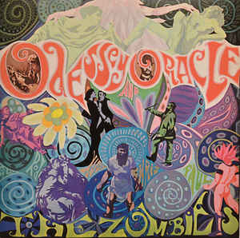
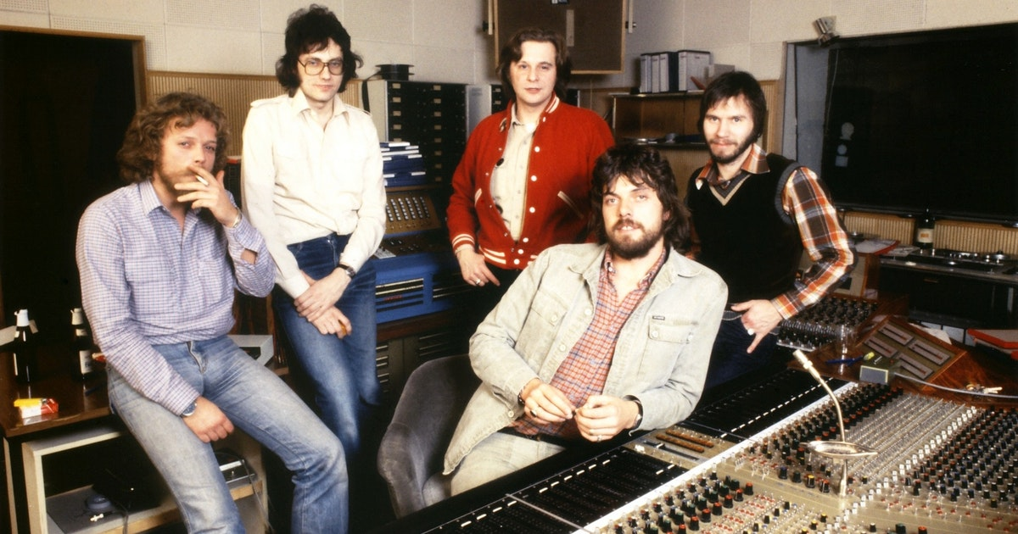
More Rock Artists at Abbey Road
The Hollies
Donovan with Sunshine Superman and Mellow Yellow
The Zombies “Odessey and Oracle
Jeff Beck’s debut album Truth
The Raspberries
Alan Parsons Project

Slide 9
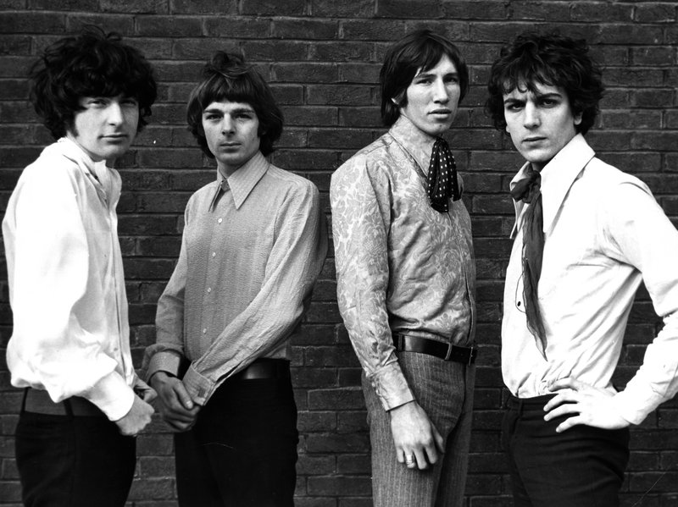
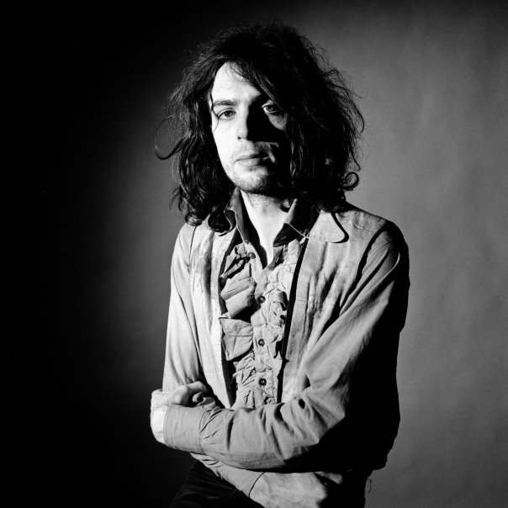
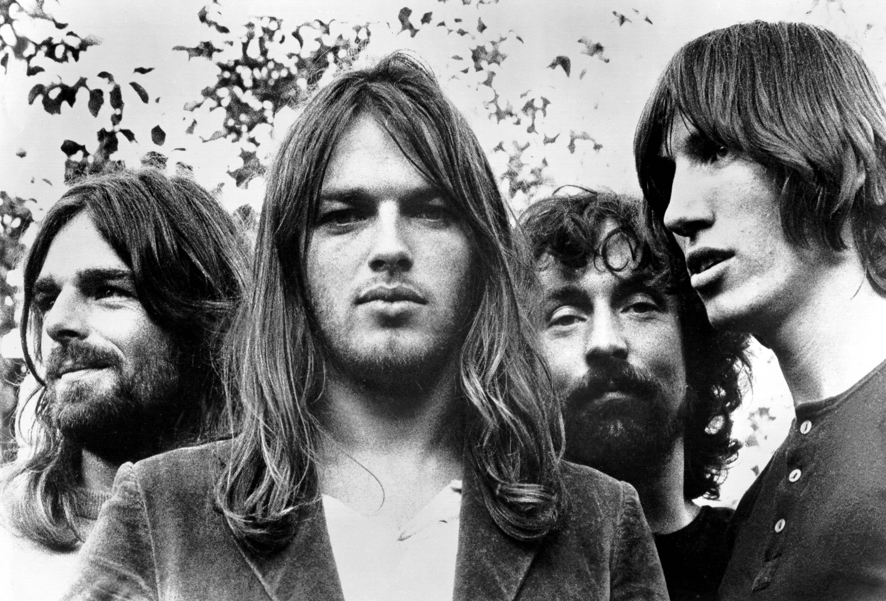
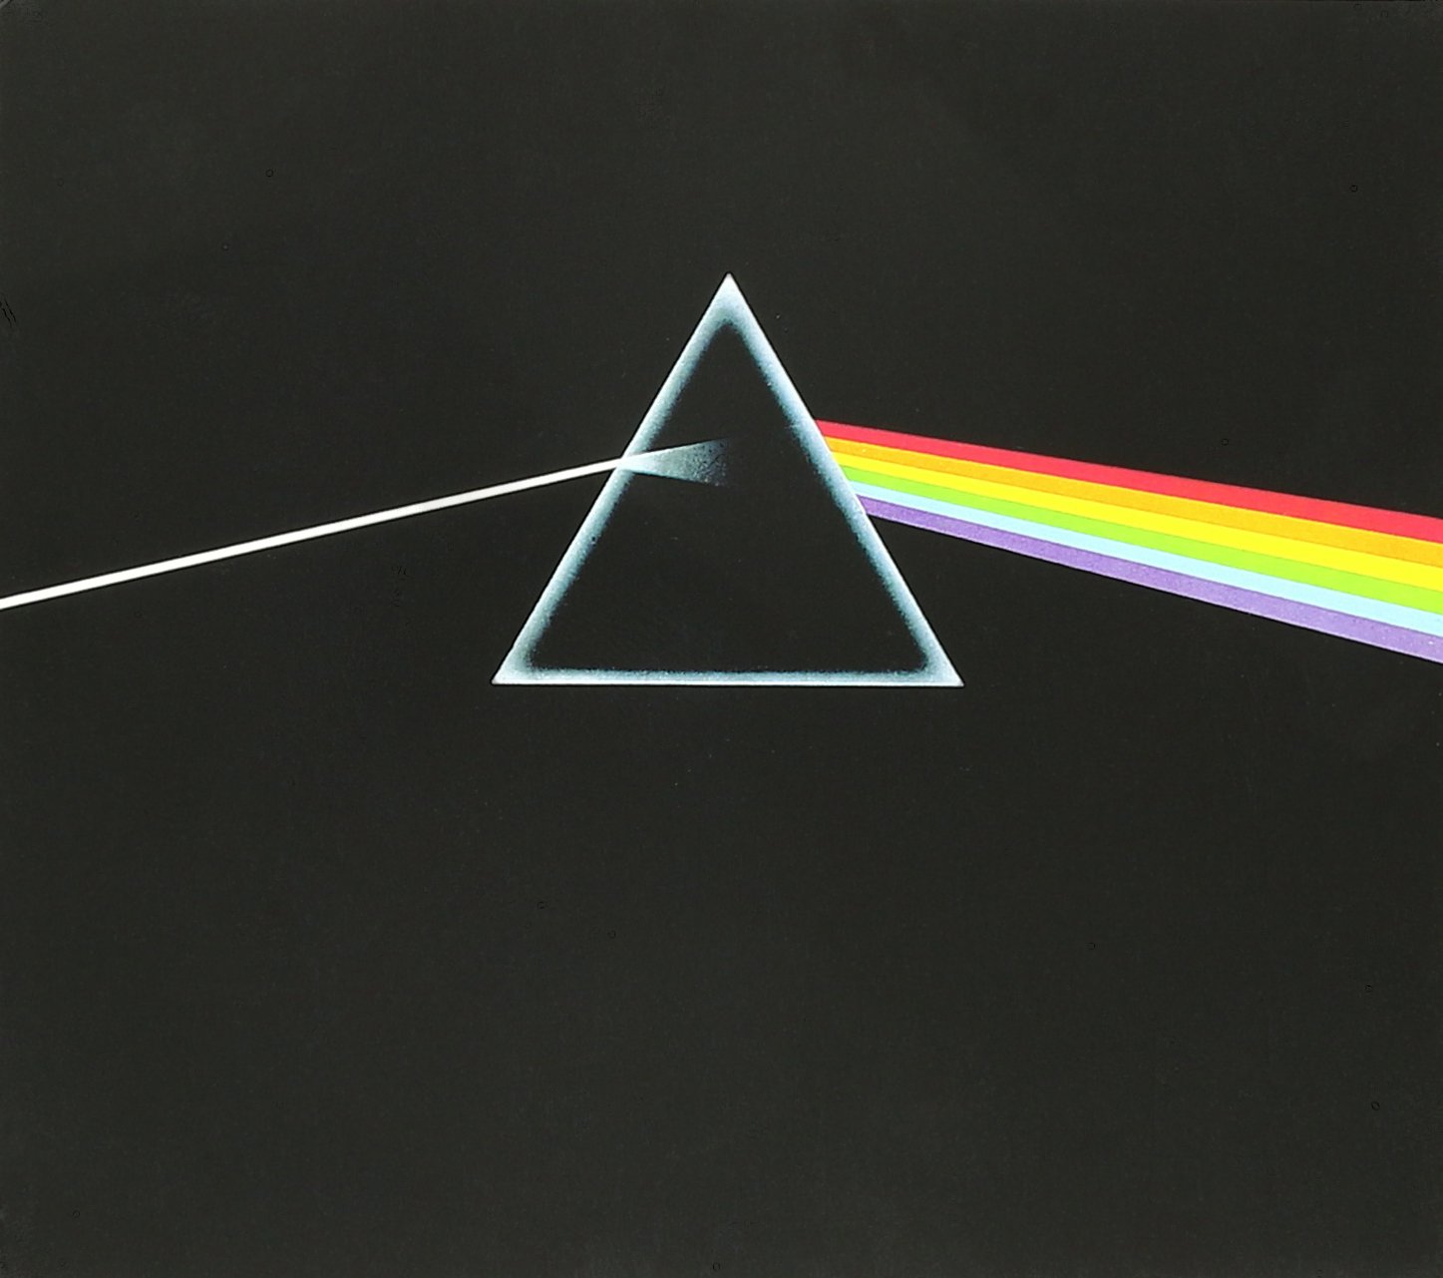
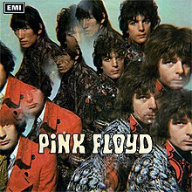
Pink Floyd
Norman Smith signed Pink Floyd in 1967
The Piper at the Gates of Dawn
Syd Barrett
David Gilmour
The Dark Side of the Moon

Slide 10
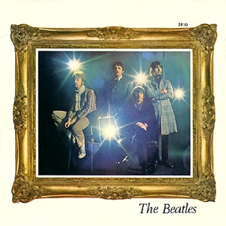
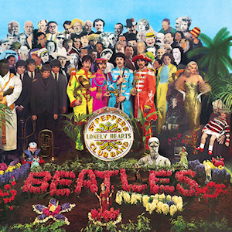

Beatles 1967
The Beatles recorded Strawberry Fields Forever and Penny Lane
Sgt. Pepper’s Lonely Hearts Club Band
All You Need Is Love

Slide 11




Beatles Final Years
New Record Label Apple Corps
The White Album
Abbey Road and Zebra Crossing
Let It Be

Slide 12




Beatles solos at Abbey Road

Slide 13



Legacy

